Slide 1
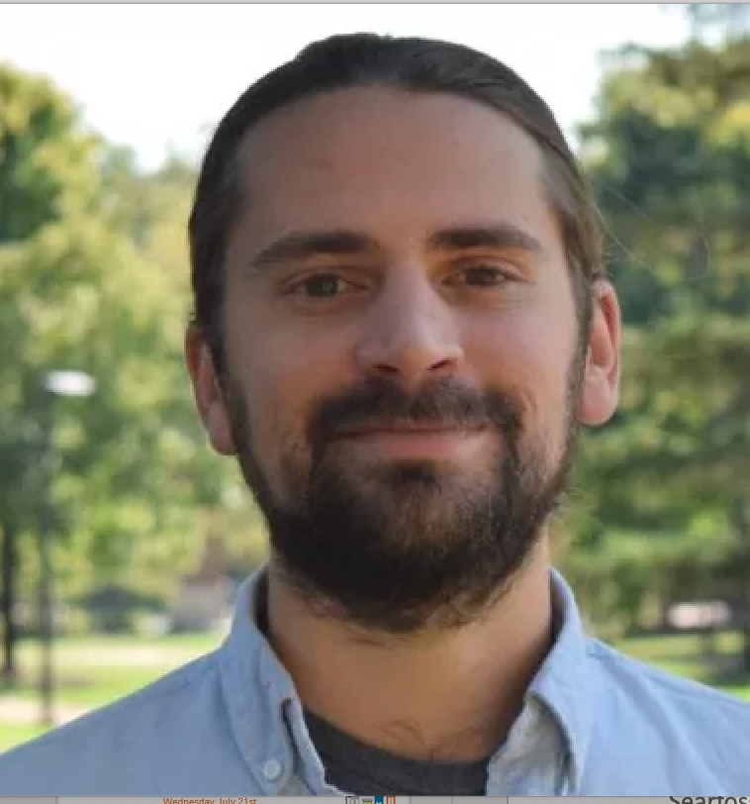
#BaltimoreDataWeek 2021
Wednesday, July 21st
11:30AM-12:45PM: Challenges and Successes in Housing
Moderator: Peter Dolkart, Federal Reserve Bank of Richmond, Baltimore Branch
Nicholas Finio,
National Center for Smart Growth, University of Maryland
#BaltimoreDataWeek
@bniajfi
bniajfi.org
Laura Searfoss,
Enterprise Advisors at Enterprise Community Foundation
Dan Ellis,
NHS of Baltimore
Baltimore Data Week is generously sponsored by:

