Slide 1
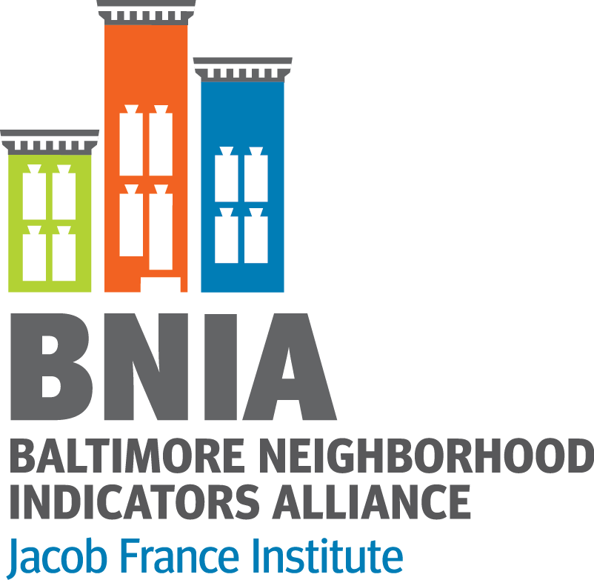
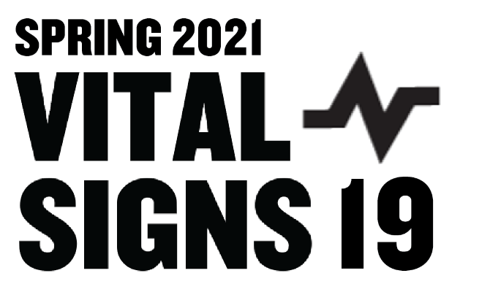
State of Baltimore’s Neighborhoods: Introduction to Vital Signs 19
Agenda
Who We Are
What Do we Know about Data from 2020?
Trends Pre-Pandemic
Key Indicators
Preview of #BaltimoreDataWeek
Website Demo
Open Data Portal Tour
#VitalSigns19/20
@bniajfi
www.bniajfi.org

Slide 2
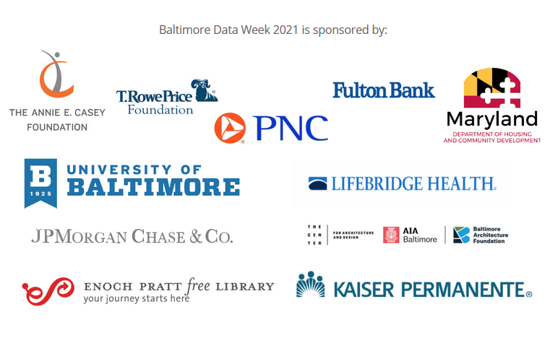
Thank you!
BNIA Staff​
Cheryl Knott, Logan Shertz, Carlos Karpati, Brittany McMullan
Data Science Fellows​
Kaitlyn Baker, Amivi Atsu, Loveth ​Akinyemi, Priya Kanneboyina
University of Baltimore Support​
Jared Schuster, Wendy James, Dean’s Office​
Our Partners
Federal Reserve Bank of Richmond
All of our Volunteer Panelists, Moderators, and Workshop leads​
Thanks to all of you!​

Slide 3
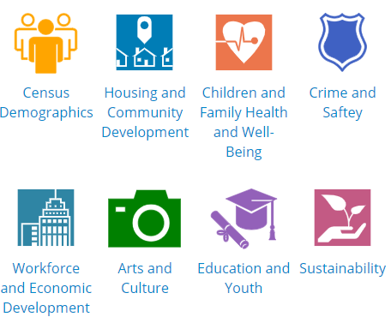
Data through 2019
Report, Interactive Website and Open Data Portal
Over 110 indicators, over 50 sources
Topic areas:
www.bniajfi.org/vital_signs
Made possible with generous support from:
Notes:
Most persons know BNIA for producing Vital Signs. The continued support we have received from the Annie E. Casey Foundation allows for us to provide the Vital Signs data for Baltimore’s neighborhoods. We currently track 129 indicators of neighborhood vitality that we believe are important to understand and plan for the future of the City and its neighborhoods.
These indicators cut across subject areas – ranging from housing, to health, to education, to safety, to sanitation.
While we make these indicators available for free at the Community Statistical Area, most of the indicators are available for customized analyses at other geographies – including neighborhood, census tract, councilmanic district, and zip code.
And as you saw this morning, we are asking for your input and guidance in selecting from our current list of indicators that are most important and looking to add those that you have said are important to track that we currently do not collect. In fact at 1pm, we will be meeting in Room 143 to further discuss the Vital Signs indicators.

Slide 4
Telling the Data Story of Baltimore's Neighborhoods

Slide 5
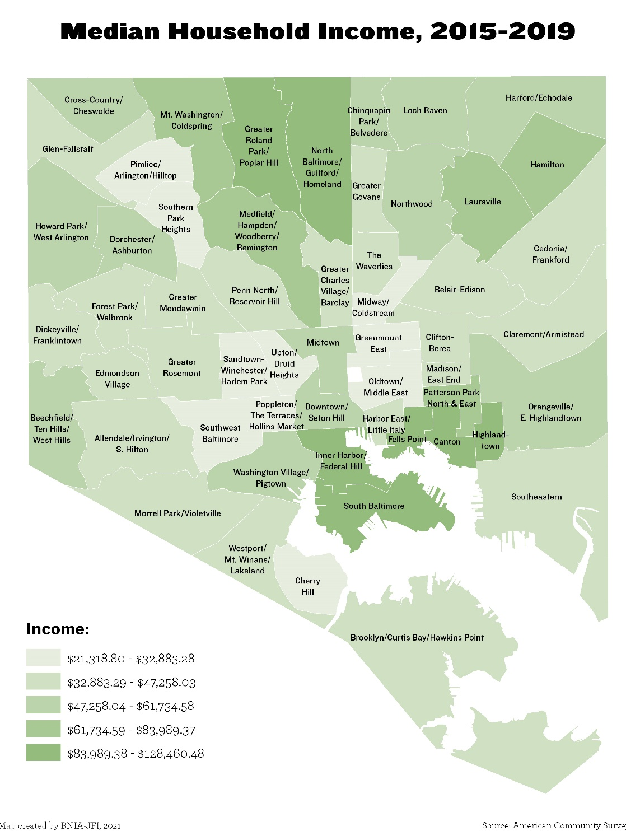
Median Household Income
Adjusting for inflation the median household income in Baltimore increased from $44,258 from 2006-2010 to $50,379 from 2015-2019.
The CSAs that experienced the greatest increases in adjusted median household income between 2006-2010 and 2015-2019 were South Baltimore (+$50,928), Canton (+$53,775) and Highlandtown (+$35,048).

Slide 6
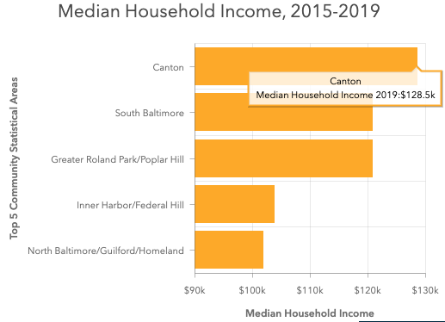
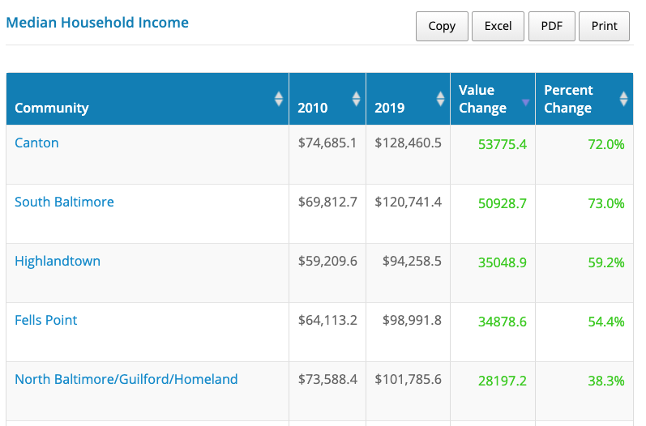
Change in Income

Slide 7
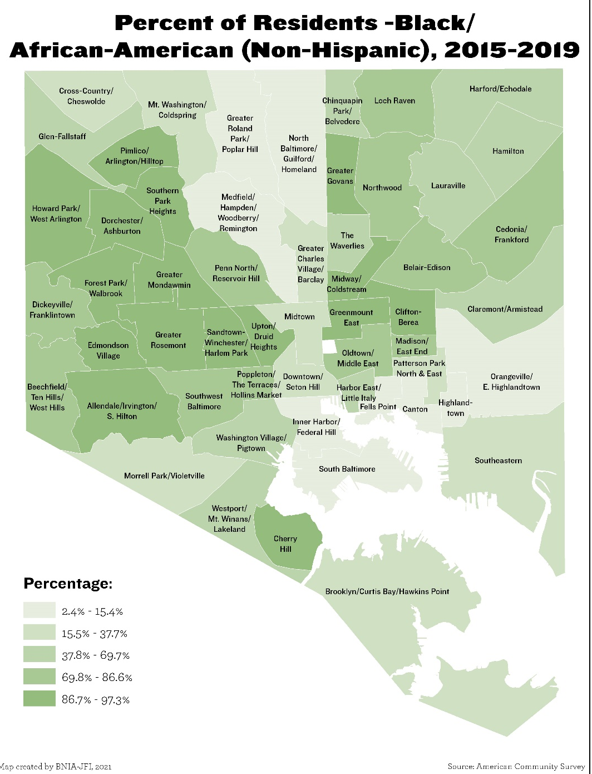
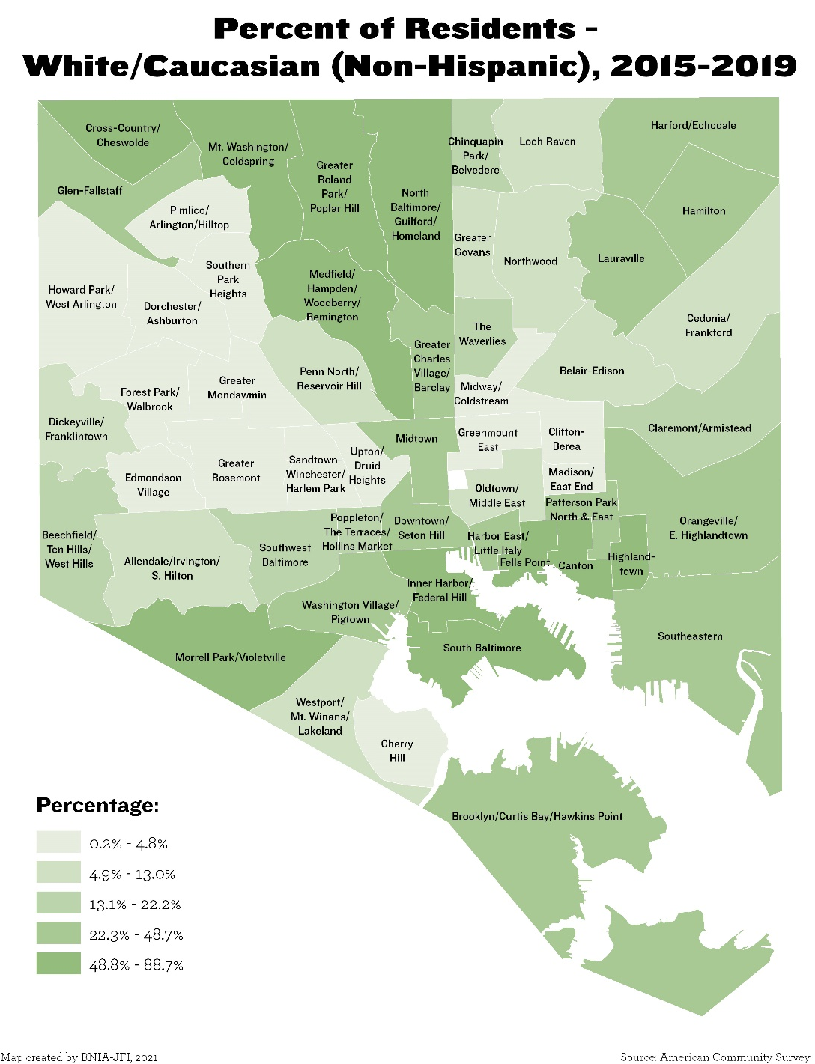
Race

Slide 8
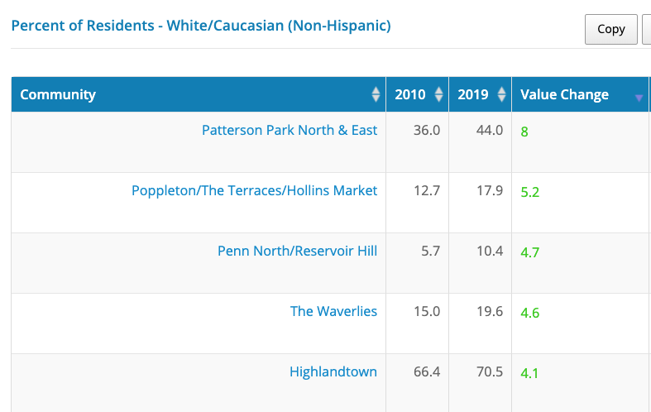
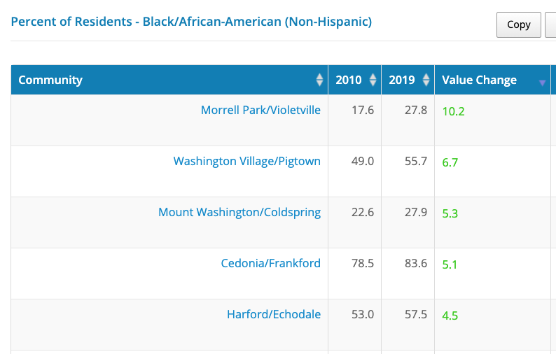
Change in Race

Slide 9
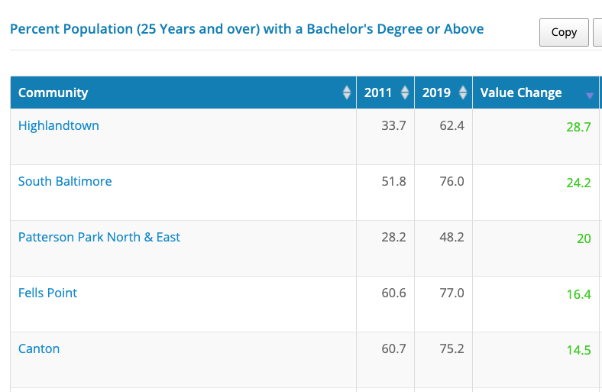
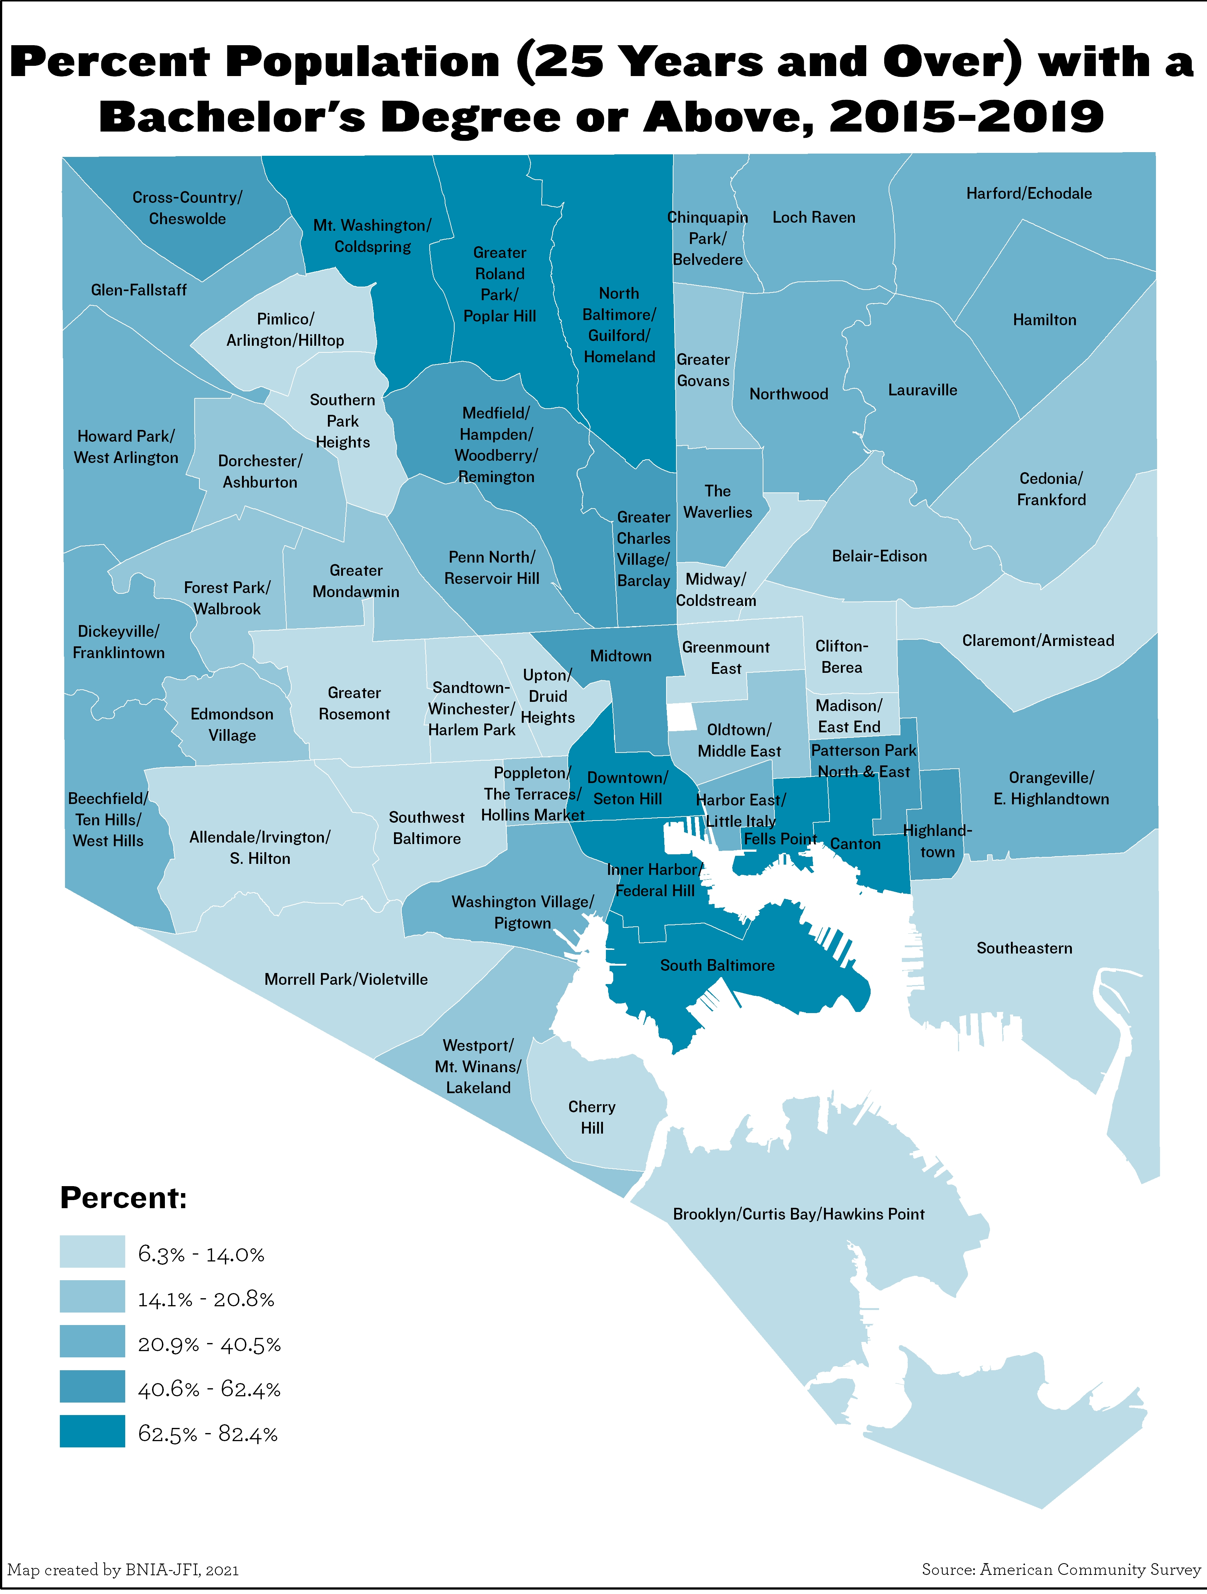
Education

Slide 10
Key Indicators During the Pandemic

Slide 11
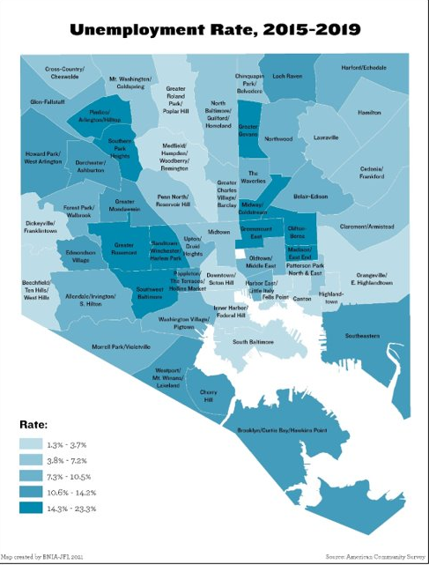
Digital Equity

Slide 12
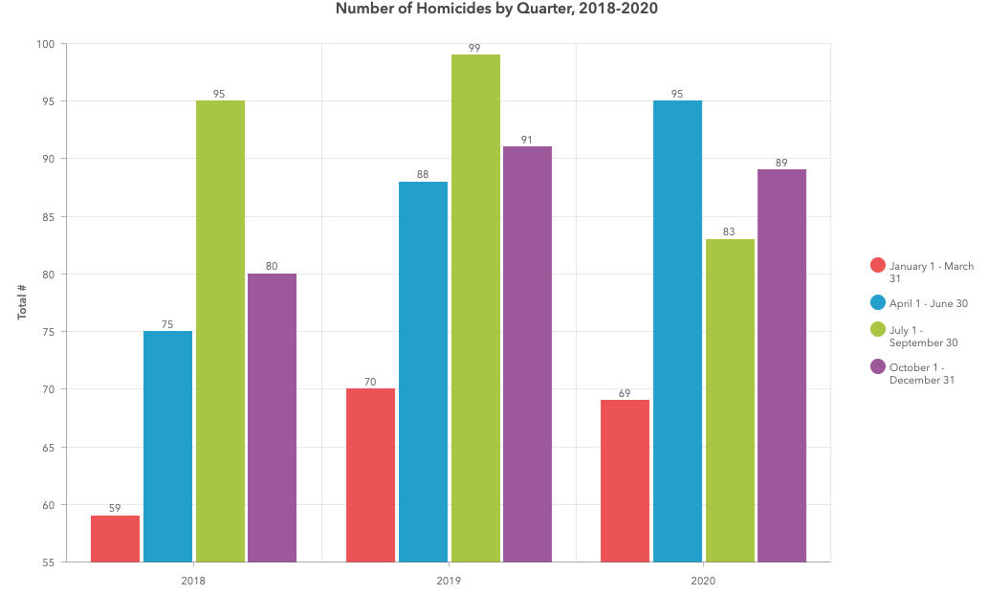
Overall Crime was WAY Down in 2020
Vital Signs indicators focus on the public realm
Evidence that private incidents (domestic violence) rose in 2020

Slide 13
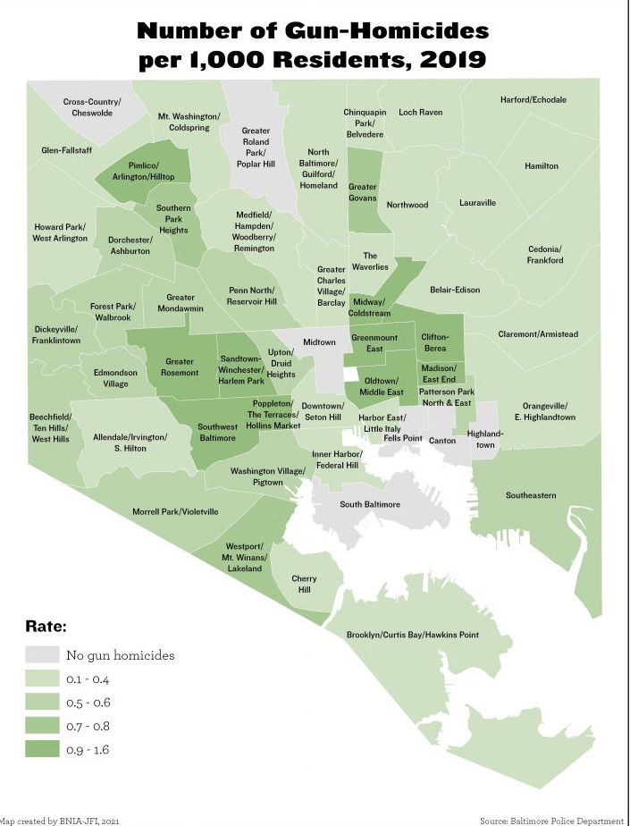
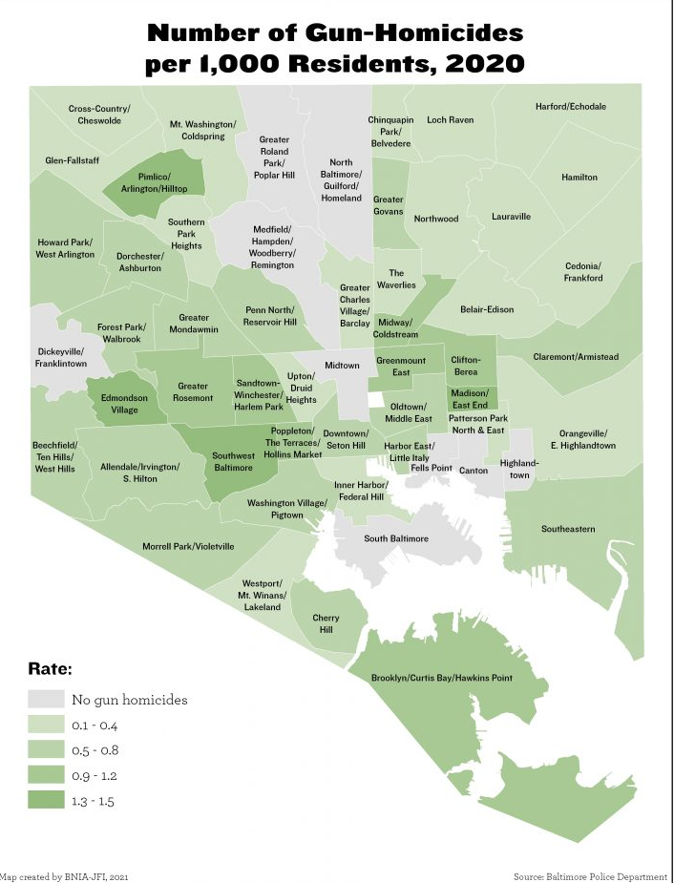

Slide 14
The Good News

Slide 15
Supplemental Nutrition Assistance Program (New!)
In 2019, the percent of the population receiving SNAP benefits was 6.3% in Baltimore.
The CSAs with the highest percentage of families receiving SNAP were Cherry Hill (11.5%), Oldtown/Middle East (11.0%), and Harbor East/Little Italy (10.7%). The CSAs with the lowest percentage included South Baltimore and Canton (0.7%).

Slide 18
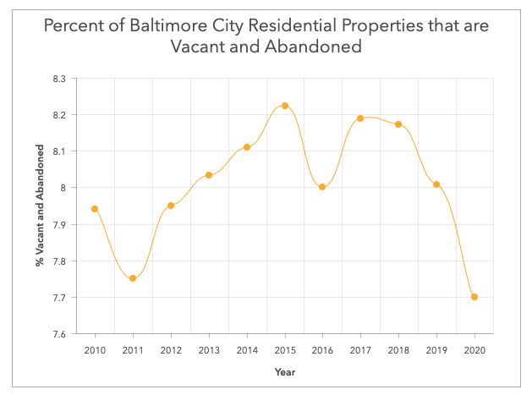
Vacant and Abandoned Properties

Slide 19
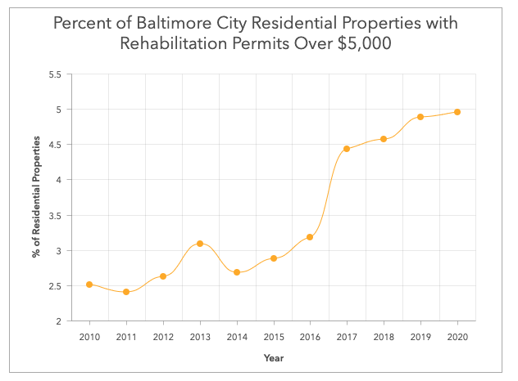
Rehabilitation Permits

Slide 20
Mortgage Origination or Approval (New!)
In 2019, 89.6% of all HMDA reported first-lien mortgage applications in Baltimore were either originated or approved but not accepted.
The CSAs with the highest percent of originated or approved mortgage applications were South Baltimore (98.6%), Medfield/Hampden/Woodberry/Remington (95.9%) and Canton (95.8%). The CSAs with the lowest percent were Southern Park Heights (67.4%) and Sandtown-Winchester/Harlem Park (71.4%).

Slide 21
School Switching
Between 2018-2019 and 2019-2020, the percentage of all students switching schools within the same school year decreased from 5.2% to 4.6%.
In 2018-2019, the CSA with the highest percentage of students switching was Greater Mondawmin and Midway/Coldstream (7.8%) and in 2019-2020 the CSAs were Clifton-Berea and Forest Park/Walbrook (7.6%).
The CSAs with the lowest percentage across both years were Greater Roland Park/Poplar Hill (0.0%), South Baltimore (0.5%), and Mount Washington/Coldspring (0.7%).

Slide 22
Preparing for Release of 2020 Census Data

Slide 23
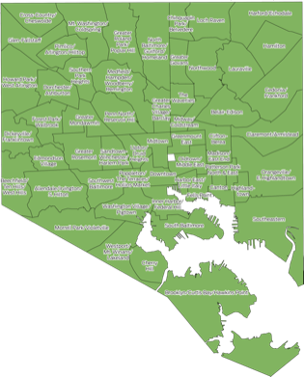
Preparing for 2020 Census Data
No boundary changes
Process for engaging neighborhoods for potential name changes
Survey during Baltimore Data Week
Work with City Council persons (Fall)
Reach out to impacted community leaders

Slide 24
Virtual (Hybrid) Baltimore Data Week 2021
July 19 | July 20 | July 21 | July 22 | July 23
 | 10:00-11:00AM: Workshop: Using Census and Business Data | 11:30AM-12:45PM: Preparing for Affordable Housing in Maryland
2:00-3:00PM: State of Baltimore’s Neighborhoods: Introduction to Vital Signs 19 | 2:00-3:15PM: Using Data to Understand the Entrepreneurial Landscape | 2:00-3:00PM: Using BNIA APIs to Visualize Baltimore’s ‘Black Butterfly’ | 12:00-2:45PM: Baltimore City Open Data: A New Administration (HYBRID session) | 2:00-4:00PM: Data for Youth Opportunities (HYBRID session)
4:00-5:15PM: Baltimore Data About COVID-19 | 4:00-6:00PM: Workshop on Building a Community Greening Dataset for Public Health Research | 4:00-5:00PM: Community Needs Assessment for Hospitals | 5:00-6:00PM: Ignite Session: Catching up with the Baltimore Data Science Corps Fellows

Slide 25
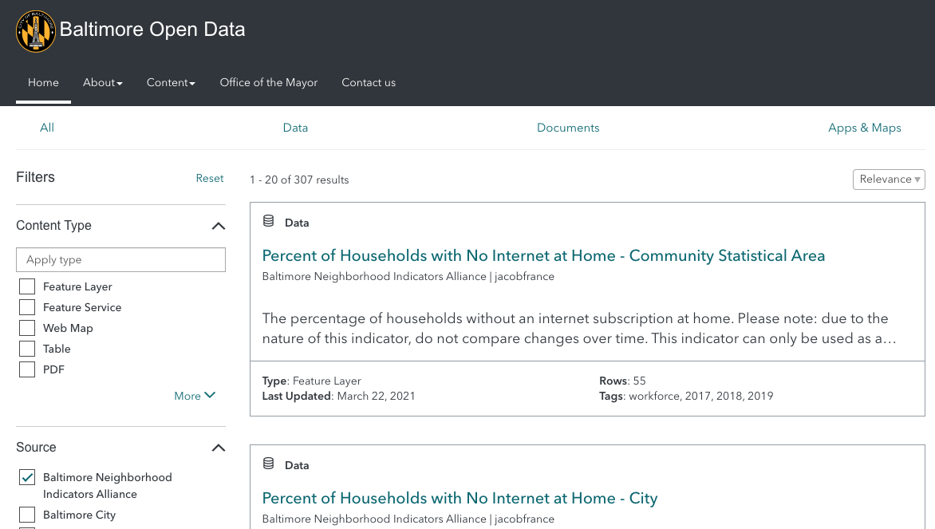
What's New? Vital Signs is on Open Baltimore!
https://data.baltimorecity.gov/search

Slide 26
Questions?
#VitalSigns19/20
@bniajfi
www.bniajfi.org

