Slide 1
Building Climate Resilience Through Smart Surfaces: The Public Health Impact
Baltimore Neighborhood Alliance
University fo Baltimore
Baltimore Data Week
July 22, 2020
Georges C. Benjamin, MD, MACP, FACEP (E), FNAPA Executive Director American Public Health Association

Slide 2
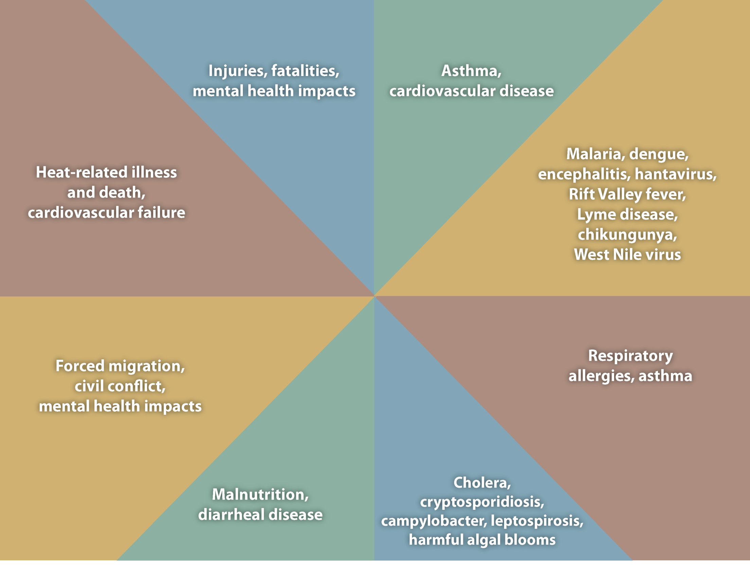
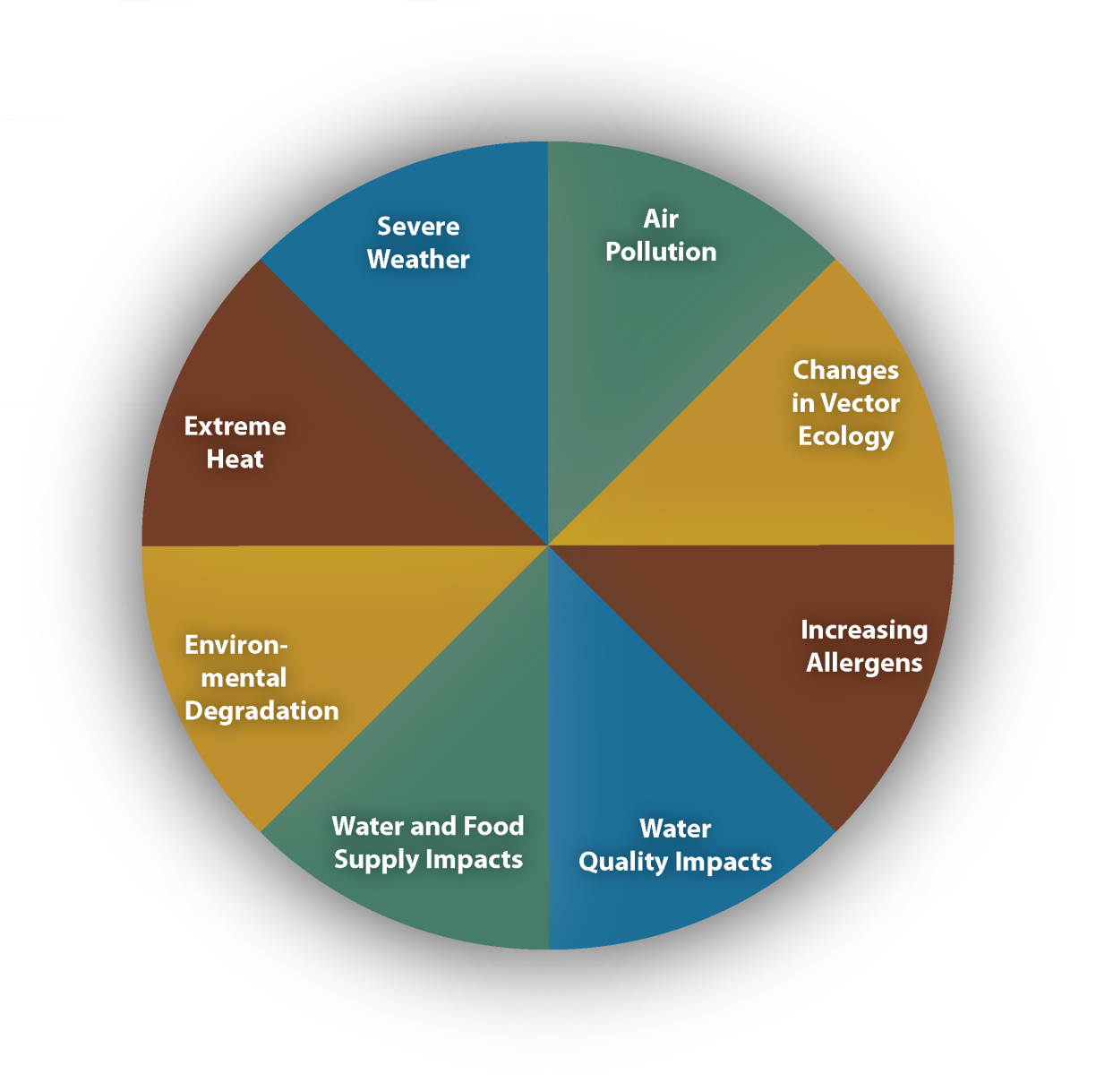
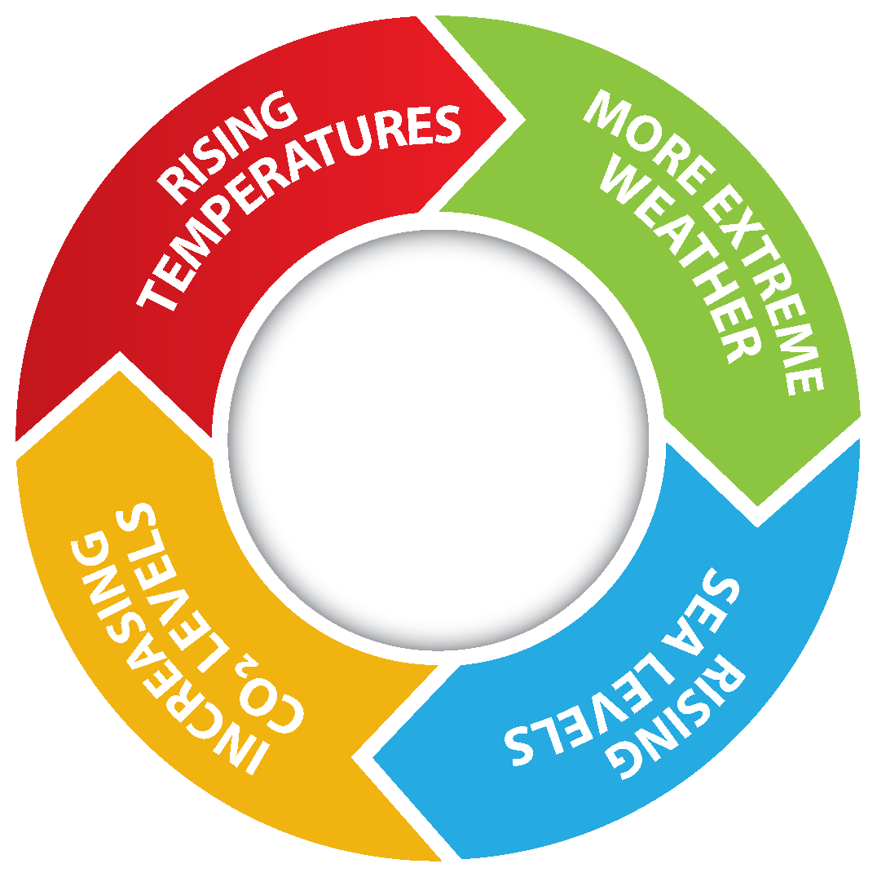
Notes:
Climate change impacts a wide-range of health outcomes. This slide illustrates the most significant climate change impacts (rising temperatures, more extreme weather, rising sea levels, and increasing carbon dioxide levels), their effect on exposures, and the subsequent health outcomes that can result from these changes in exposures.

Slide 3
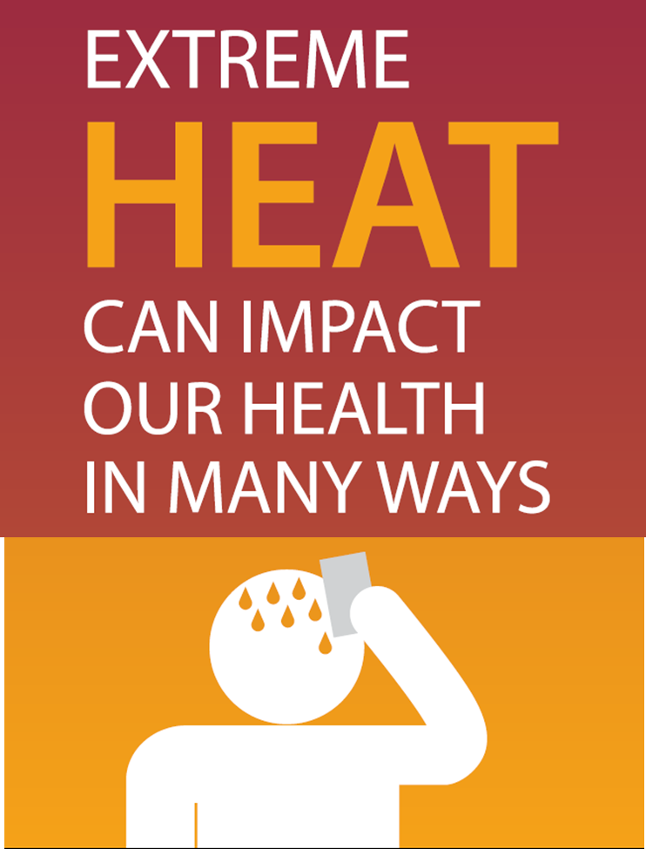
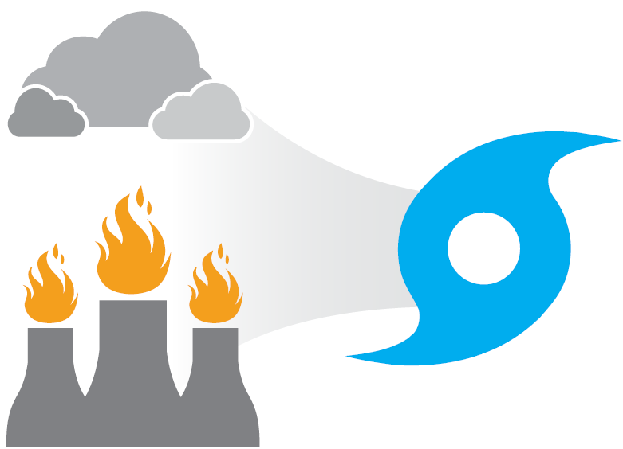
EXPOSURES
Longer and hotter warm season
Heat waves
THREATS TO HEALTH
Heat-related illness
Respiratory and heart diseases
Death
Burns from wild fires
www.apha.org/climate
Notes:
Number of deaths related to extreme heat; if possible, increased number of heat-related deaths over time
NRDC projects that over 150,000 Americans could die by the end of this century due to the excessive heat caused by climate change (an estimate covering the top 40 cities in the US). California heat wave in 2006 caused 655 deaths in 2 weeks. Chicago heat wave of 1995 caused 700 deaths July 11-27) http://www.nrdc.org/globalwarming/killer-heat/.
heat and extreme heat is the one climate effect that is felt across the country
And it has many health impacts, such as
Heat stroke
Dehydration and diarrheal disease
Amplifies pre-existing conditions, like
Respiratory illnesses
Cardiovascular disease
Mental health
And more
Longer heat days can lead to
An increase in allergy season, also causing asthma
And creating new habitats for vector-borne diseases, like
Mosquitos that carry the Zika virus
Vampire Bats that carry rabbis

Slide 4
The Climate Burdon Is Not Shared Equally
Climate-sensitive populations have limited resources to adapt to climate change and have disproportionately greater adverse climate impacts including health
Extremes of age
Lower income
Some minorities
Vulnerability to climate change impacts depends on community resilience
Communities can increase general resilience by addressing the societal factors that influence health

Slide 5
Societal Factors That Influence Health
High-quality schools
Job opportunities
Healthy housing
Nutritious food
Safe communities
Green space
Quality healthcare
Good public transit
Social cohesion
Social capital
Toxic exposures
Built environment

Slide 6
Built Environment Influences Temperature
Dark urban surfaces absorb, rather than reflect most of the sun’s heat—heating the city and increasing air pollution
Lack of vegetation and trees to absorb heat, reduce pollution, and provide shade
Dark surfaces make cities ~9 degrees warmer on average, but this effect is aggravated in low-income neighborhoods with less vegetation and more dark surfaces

Slide 7
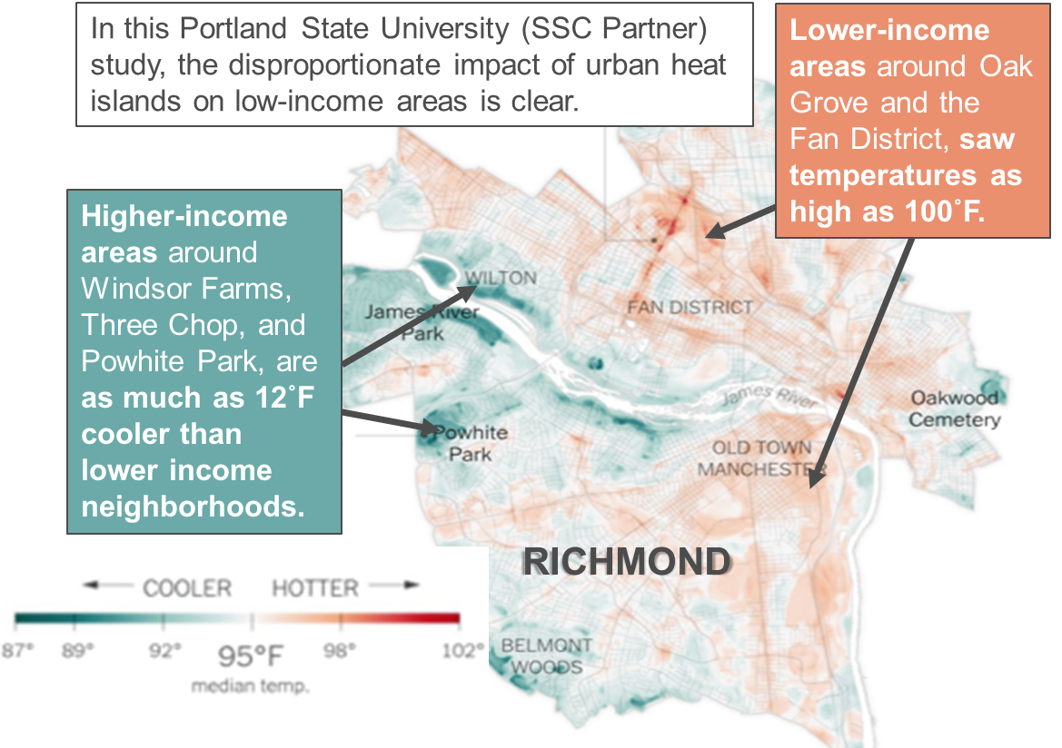
Cities are Getting Hotter
Especially Lower - Income areas

Slide 8
Baltimore City Summer 2018: Heat Index 103⁰ F
Increased emergency medical service calls
Heat stroke more than doubled
Chronic obstructive pulmonary disorder increased 70%
Respiratory distress increased 20%
Cardiac arrest rose 80%
Hypertension more than doubled
Psychiatric disorders, substance abuse, and dehydration spiked
Increased hospital visits for Medicaid patients in hotter versus cooler areas of city
Low-income patients in hot spots had more doctor visits for asthma, COPD and heart disease

Slide 9
Baltimore City Summer 2018: Heat Index 103⁰ F

Slide 10
Low-income Neighborhoods Hotter
And Residents More Vulnerable

Slide 11
Smart Surfaces A Integrated Strategy
To Address Climate Change
Cities can cut CO² equivalent emissions by 10 - 15 % from:
Increasing reflectivity of roofs, streets and parking lots
Reducing fossil fuel use
Increase solar PV, replacing dirty grid electricity
Reduce radiant heat from surfaces and decrease city-wide temperature, reducing electricity use

Slide 12
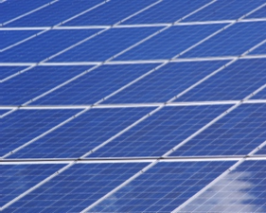
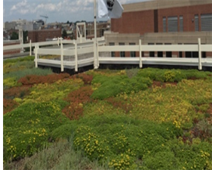
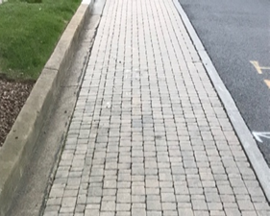
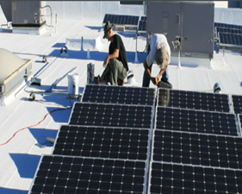
Smart Surfaces Help Better
Manage Sun & Rain
Reflective roofs are light colored and reflect most light and heat, much of which exits the atmosphere, slowing global warming.
Solar PV converts sunshine into electricity and provides shading for buildings, sidewalks, and other public areas.
Green roofs provide shading, reduce building energy use, clean the air, and absorb and clean water.
Trees reduce temperature by providing shade, clean air pollutants, reduce flooding risk and sequester carbon.
Porous pavements allow rain to recharge ground-water, reducing pollution, storm water runoff and flood risk.
Combined Solutions such as solar PV on reflective roofs or roads that are both reflective and porous - managing both sun and rain.

Slide 13
Smart Surface: Implementation Examples
Dark, impervious road, due for resurfacing
↑ Reflectivity
Add shade trees
Make parking lanes pervious
Dark, impervious parking lot
↑ Reflectivity
Add trees, bioswales
Dark, impervious roofs
↑ Reflectivity
Add solar PV
Add adjacent bioswale to absorb rain runoff

Slide 14
Smart Surfaces: Cooler, Healthier Communities

Slide 15
The American Public Health Association champions the health of all people and all communities. We are the only organization that combines a nearly 150-year perspective, a broad-based member community and the ability to influence federal policy to improve the public’s health. Learn more at www.apha.org.
About APHA
Founded – April 18, 1872
501C(3) & Nonpartisan
Over 50,000 individual & affiliate members

