Slide 1
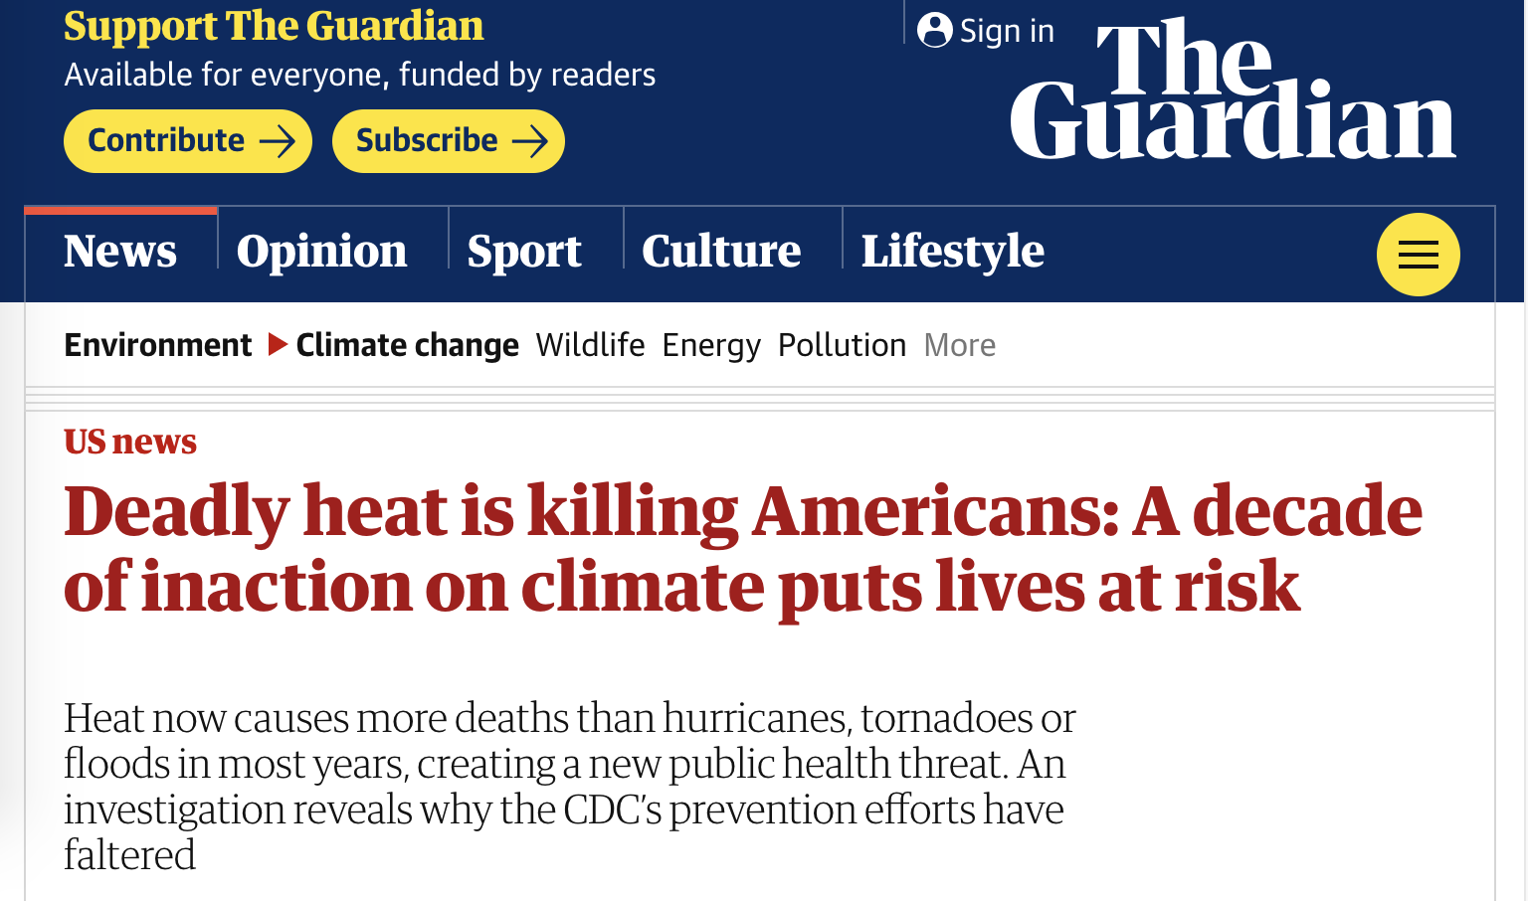
Collaboration between Columbia Journalism Investigations and the Center for Public Integrity, co-published by The Guardian, The Nation, Mother Jones, Grist, and others
Elisabeth Gawthrop - @egawthrop

Slide 2
“Heat is everyone’s problem and no one’s responsibility.” - Liza Kurtz, Arizona State University
So there are opportunities in multiple realms of communities to make heat risk either more or less severe.
Our built environment and other human actions influence our local temperatures. So should heat be regulated?
Elisabeth Gawthrop - @egawthrop

Slide 3
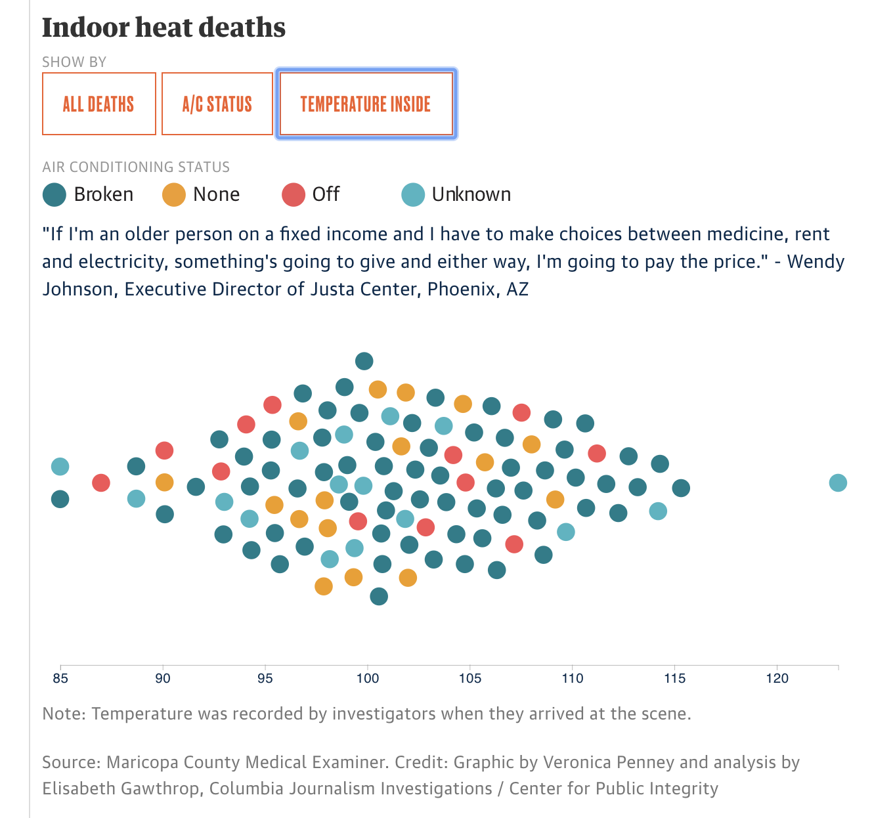
Linking heat + health through data
Created this data by going through autopsy records (PDFs).
Data source: Maricopa County Medical Examiner’s Office, with help from the county health department.
Elisabeth Gawthrop - @egawthrop

Slide 4
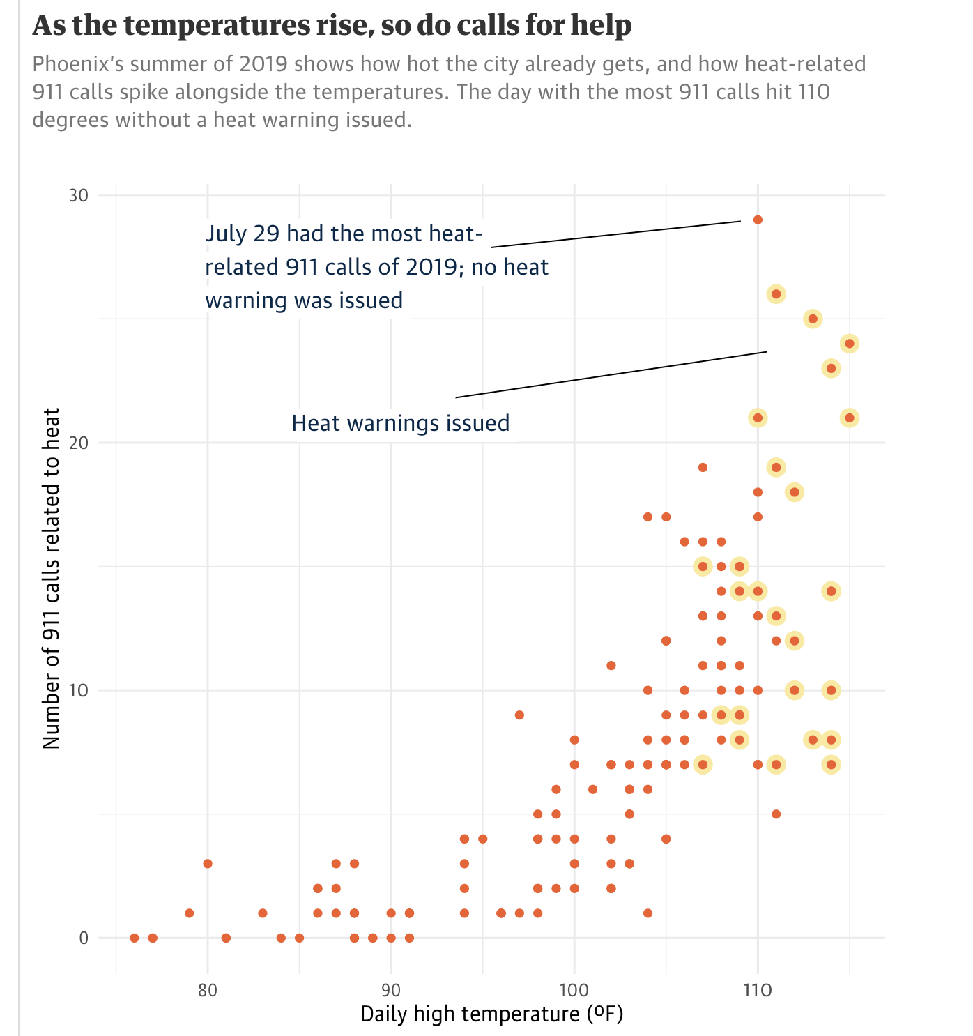
Linking heat + health through data
Challenge of getting data for daily-level health outcomes.
Created this figure by combining data from the City of Phoenix, NOAA’s National Climatic Data Center and the local office of the National Weather Service.
Elisabeth Gawthrop - @egawthrop

Slide 5
Other data sources
For hyperlocal temperatures - satellite data - see CODE RED: Baltimore's Climate Divide
State climatologist office
Environmental Public Health Tracking Network - CDC and state level
Health Department Office of Vital Statistics
Centers for Medicare & Medicaid Services
Healthcare Cost and Utilization Project (not free)
General tip - any time you fill out a form and give it to a government agency, that most likely goes into a database, and you can request that data through a records request.
Understanding the specific role your local agencies play, what they do, can help you understand what data they might have. And it may not always be in the form of a “database”.
Elisabeth Gawthrop - @egawthrop

