Slide 1
Census Data
For
Community
Analysis
Noemi Mendez
US Census Bureau

Slide 2
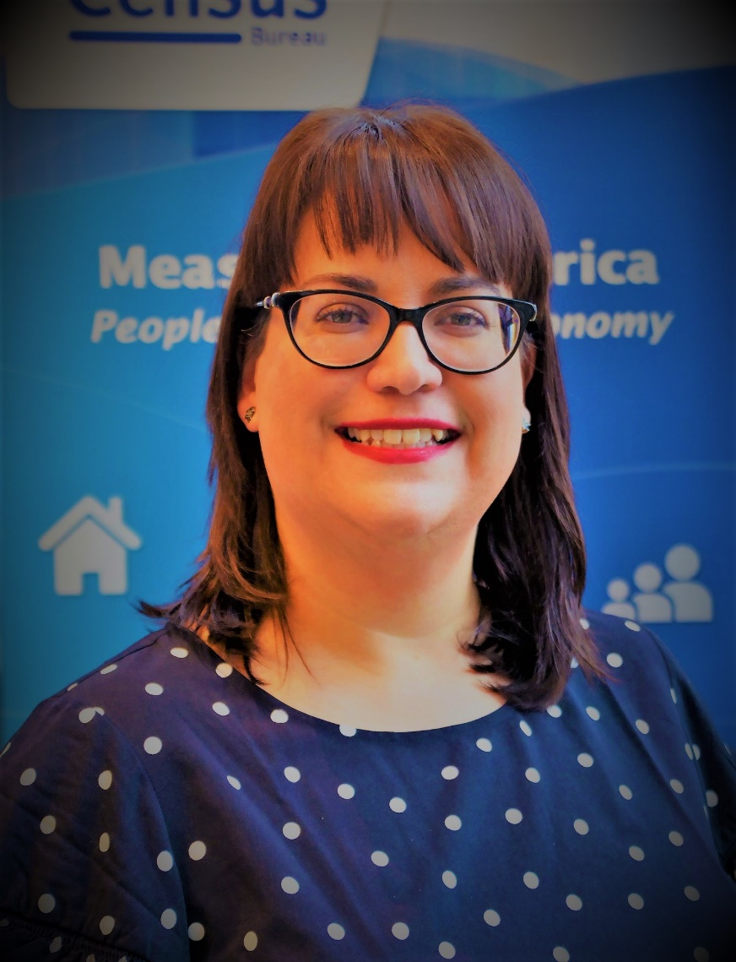
Noemi Mendez is a Data Dissemination Specialist with the US Census Bureau where she has worked for the past 16 years.
She specializes in working with grant writers, GIS users, businesses and educational institutions. She attended Syracuse University and CUNY Hunter College.
In addition to her work with the Census Bureau, Noemi teaches GIS and data visualization courses at Johns Hopkins University and Temple University.

Slide 3
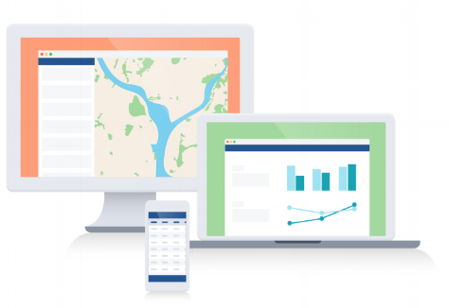
Agenda

Slide 4
Census Mission
To serve as the leading source of quality data about the nation’s people and economy.

Slide 5
Census History
Constitution signed Sept. 17, 1787
Constitution Article 1, Section 2
Census Act March 1790
First county in the world to implement a comprehensive and regular count of its population
Notes:
The Census Act of 1790. This is the original act which provided for the very first taking of the census in 1790, which was passed during the 2nd Session of the First Congress in March of 1790

Slide 6
We Collect Data
Notes:
Data we collect:
Population & Housing Census: 10 years
Economic Census: 5 years
Census of Governments: 5 years
American Community Survey: Annually
Other Surveys: Varies
Economic Indicators: Varies

Slide 7
Notes:
To determine the distribution of Congressional seats to states-- mandated by the U.S. Constitution.
used to apportion seats in the U.S. House of Representatives.
used to define legislature districts, school district assignment areas and other important functional areas of government.
To make decisions about what community services to provide.
To distribute more than $700 billion in federal funds to local, state and tribal governments each year.

Slide 8
Answers to Questions
How many people live in your community?
What are their races and ethnicities?
How many are single parents?
How many grandparents are caregivers?
What languages do they speak?
How many are in poverty?

Slide 9
How to Use Census Data
Three Things You Need To Know:
Geography (State, County, ZIP or Census Tract)
Subject
Demographic (Age, Sex, Race/Ethnicity, Poverty)
Economic (Number of Businesses, Types, etc.)
Time Frame
2000/2010 Census
2015-209 ACS
2017 Economic Census
Annual Surveys/Reports

Slide 10
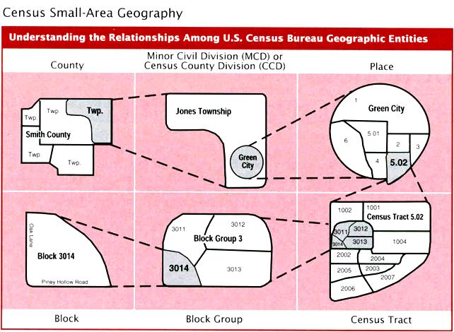

Slide 11
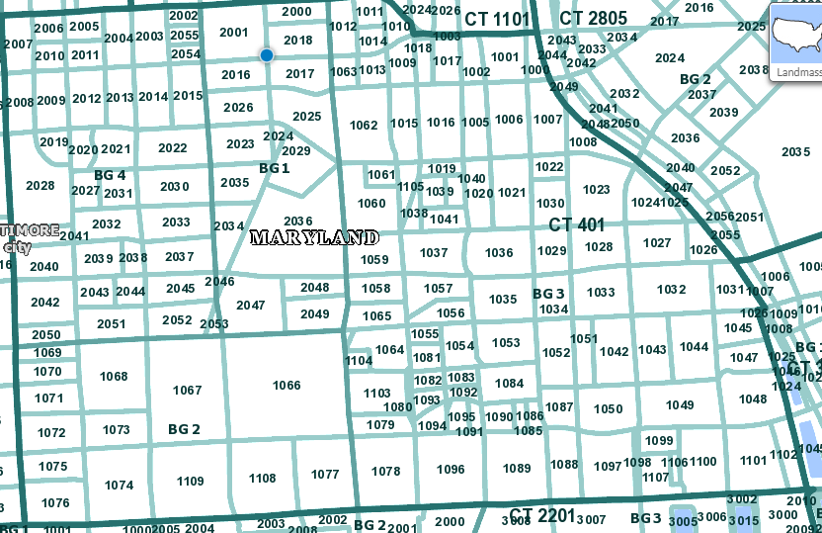

Slide 12
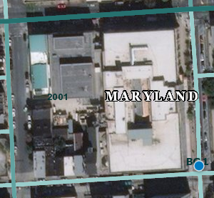
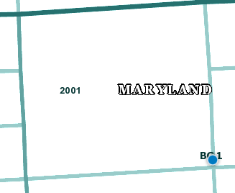

Slide 14
Demographic Data Sources
Decennial Census:
Conducted Every 10 years
Also known as 2010 Data
Official Count of Population
Basic Characteristics
American Community Survey (ACS):
Monthly Survey of US population
Characteristics of the US Population
1 and 5 year samples (based on population thresholds)

Slide 15
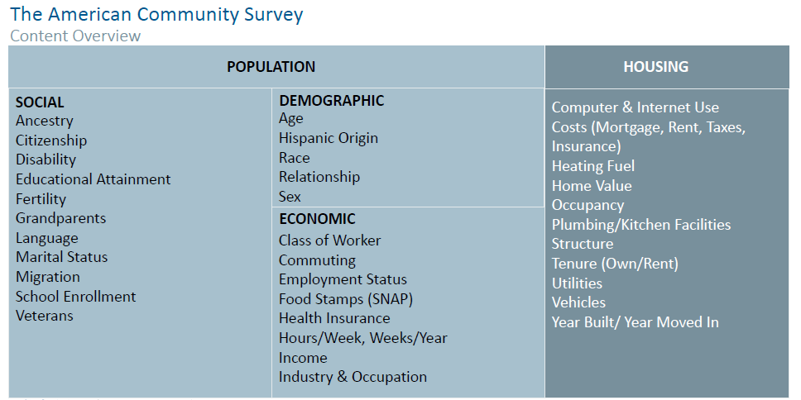

Slide 17
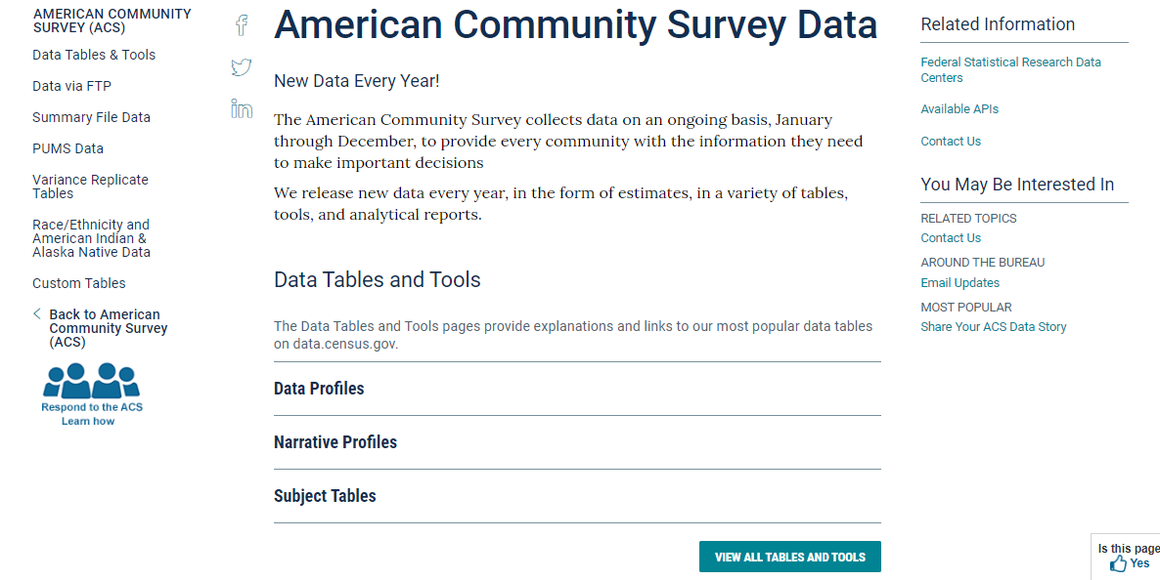

Slide 18
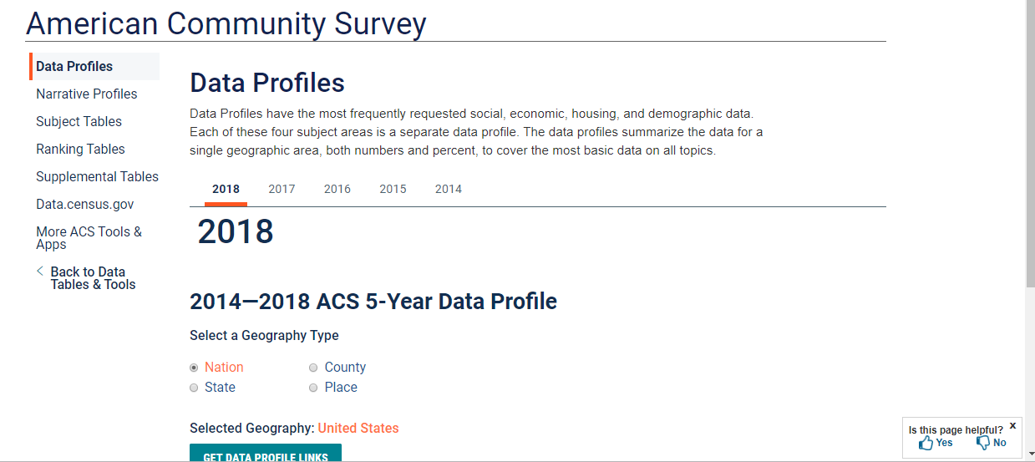

Slide 19
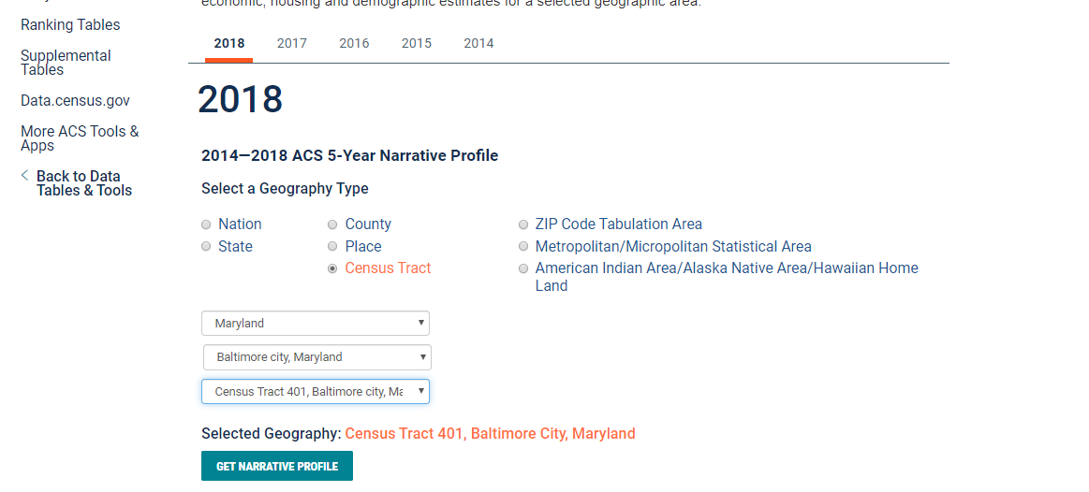

Slide 21
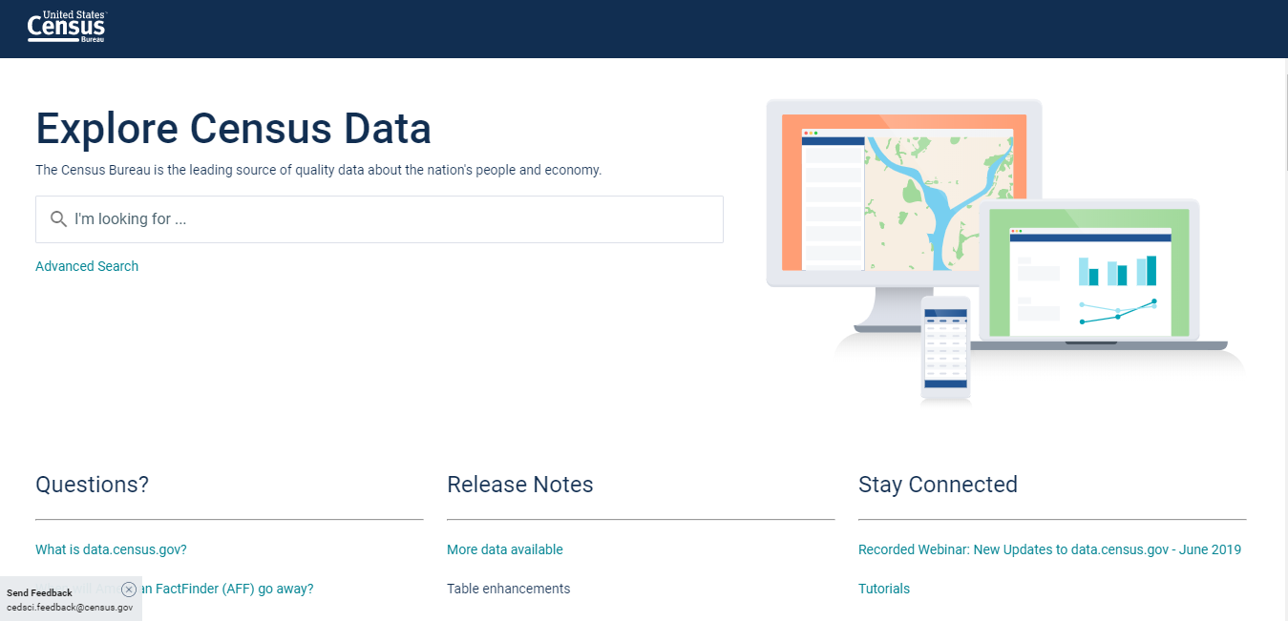

Slide 22
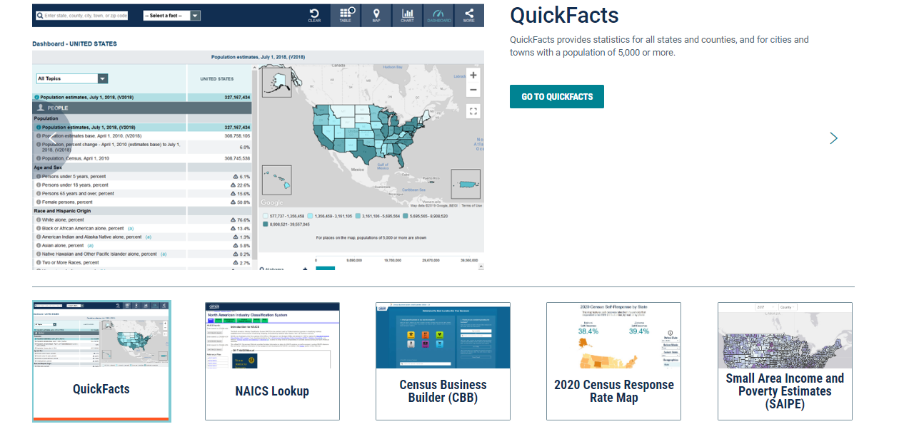

Slide 23
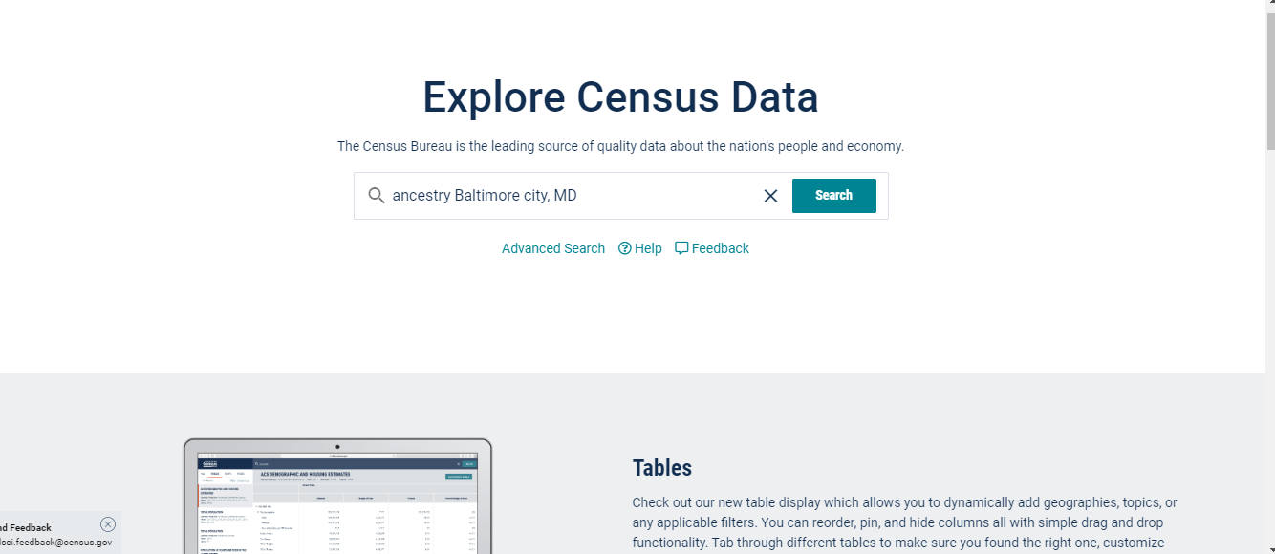

Slide 24
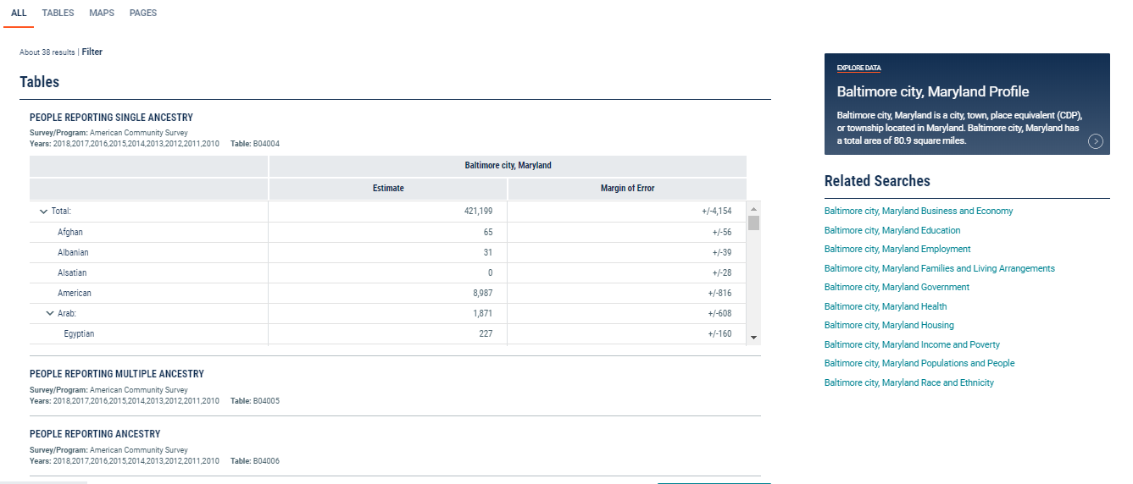

Slide 25
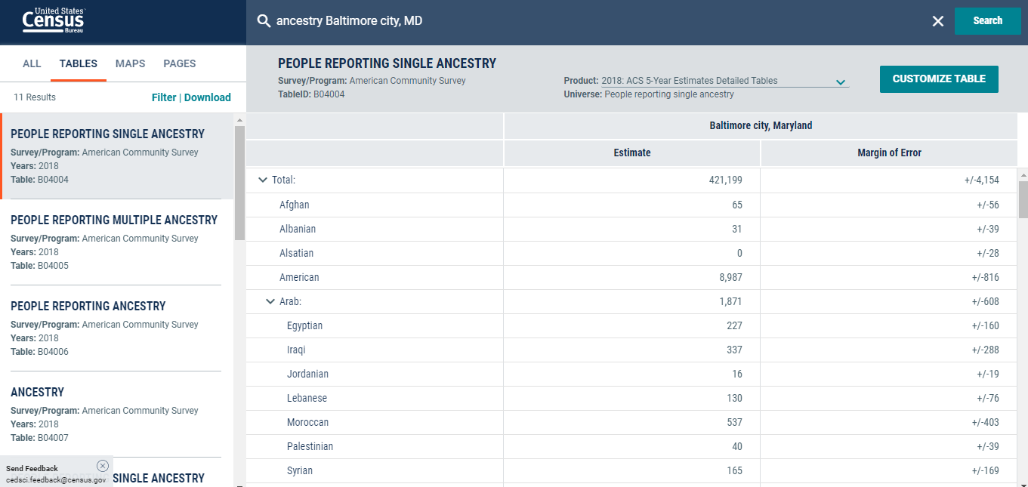

Slide 26
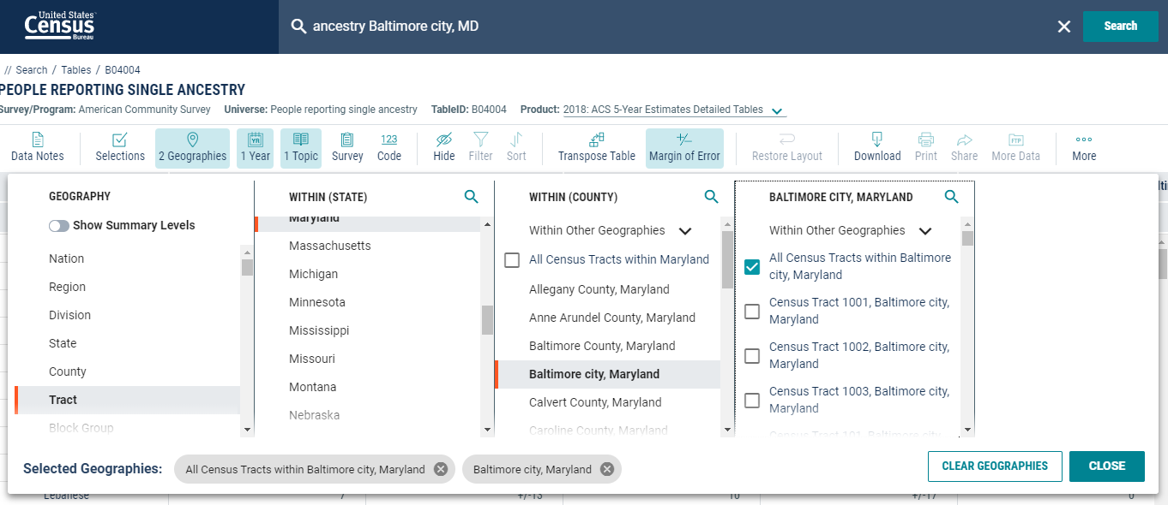

Slide 27
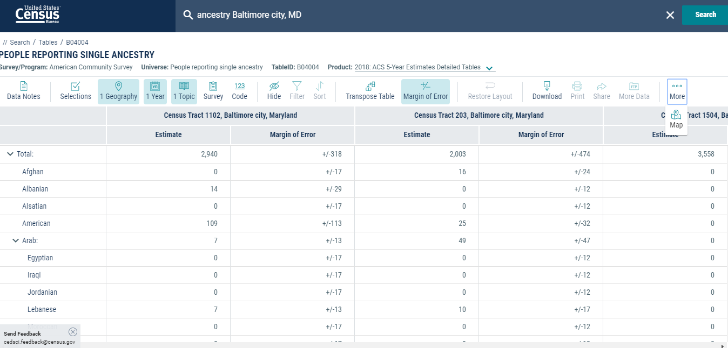

Slide 28
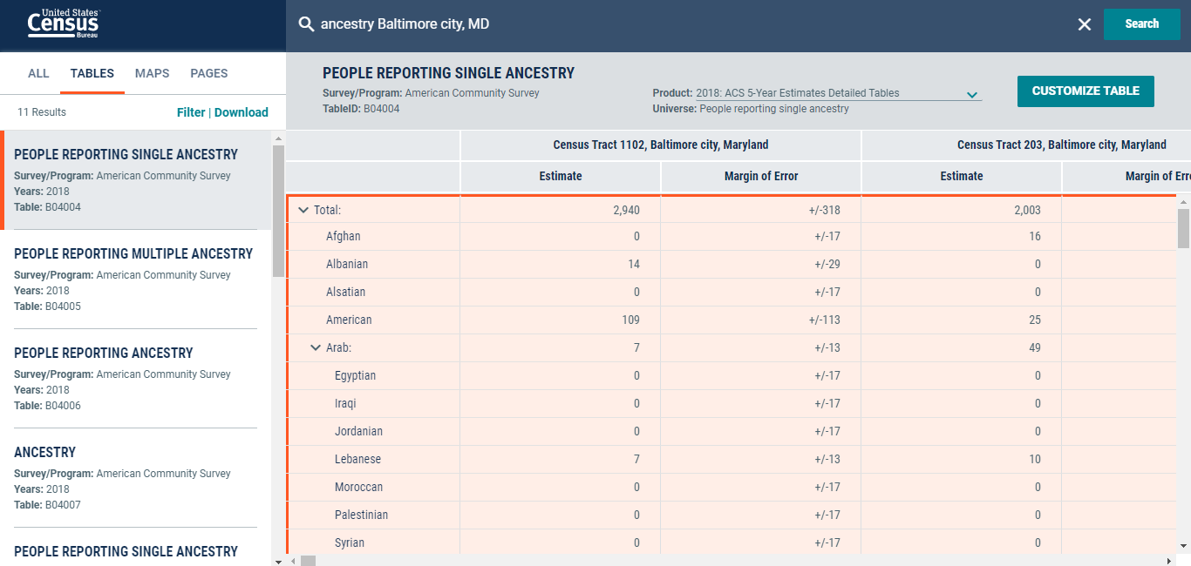
Hold CRTL + A buttons to copy and paste into Excel.

Slide 29
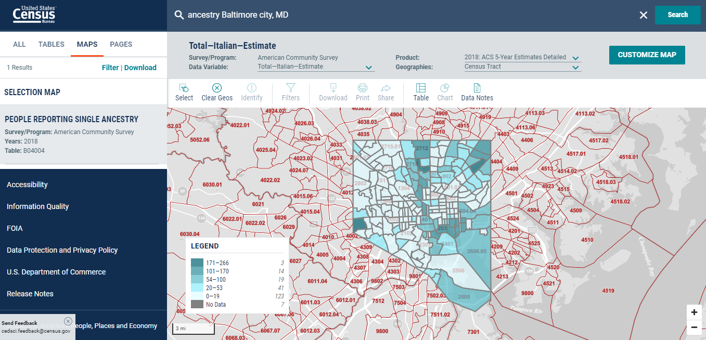

Slide 30
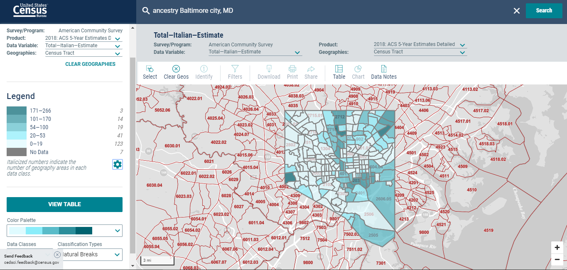

Slide 31
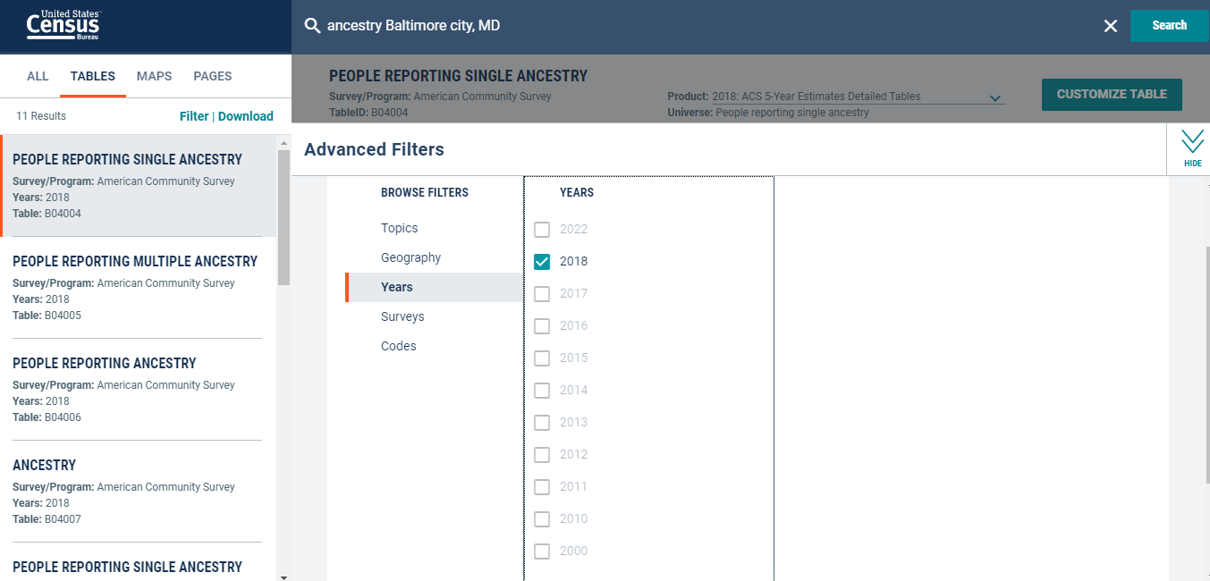

Slide 32
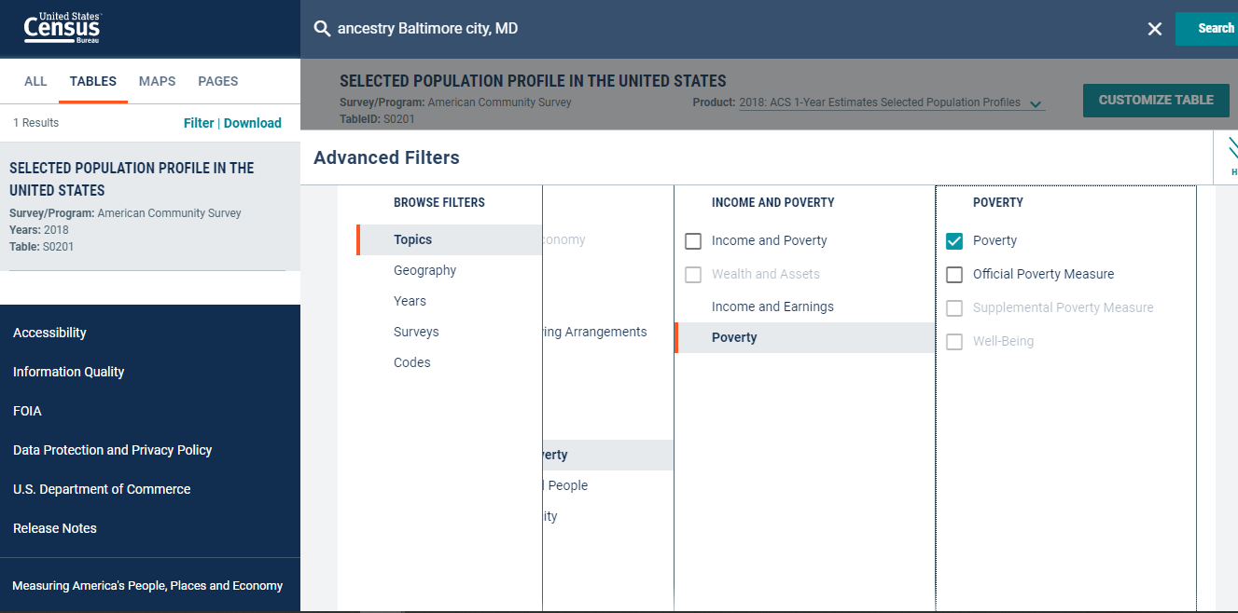

Slide 33
Resources
American Community Survey https://www.census.gov/programs-surveys/acs
Data.Census.Gov https://data.census.gov/cedsci/
Census Academy https://www.census.gov/data/academy.html
Census Academy Population Webinars: https://www.census.gov/data/academy/topics/population-characteristics.html

Slide 34
Thank You.
Noemi Mendez
U.S. Census Bureau
noemi.mendez@census.gov
askdata.census.gov

