Slide 1
Baltimore City Speed Test Data
Are all Baltimore City communities getting access to high speed data?

Slide 2
Background Information
The internet speed tests conducted by the Measurement Lab include (not exhaustively) of upload speeds, download speeds, round trip time (RTT). The super fastest internet speed advertised by some internet providers is about 1,000 megabites per second (mbps) and a slower internet speed (basic internet plan) will be around 25 mbps.
If you want ... | You'll need about...
General web surfing, email, social media | 1 Mbps
Online gaming* | 1-3 Mbps
Video conferencing** | 1-4 Mbps
Standard-definition video streaming | 3-4 Mbps
High-definition video streaming | 5-8 Mbps
Frequent large file downloading | 50 Mbps and up
Internet Speed | Users Supported | Speed Summary
25 Mbps | 1-2 | Basic
100 Mbps | 3-4 | Average
200 Mbps | 4-5 | Fast
500 Mbps | 5+ | Very Fast
1000 Mbps | 5+ | Gigabit
Nerdwallet.com
Broadbandnow.com

Slide 3
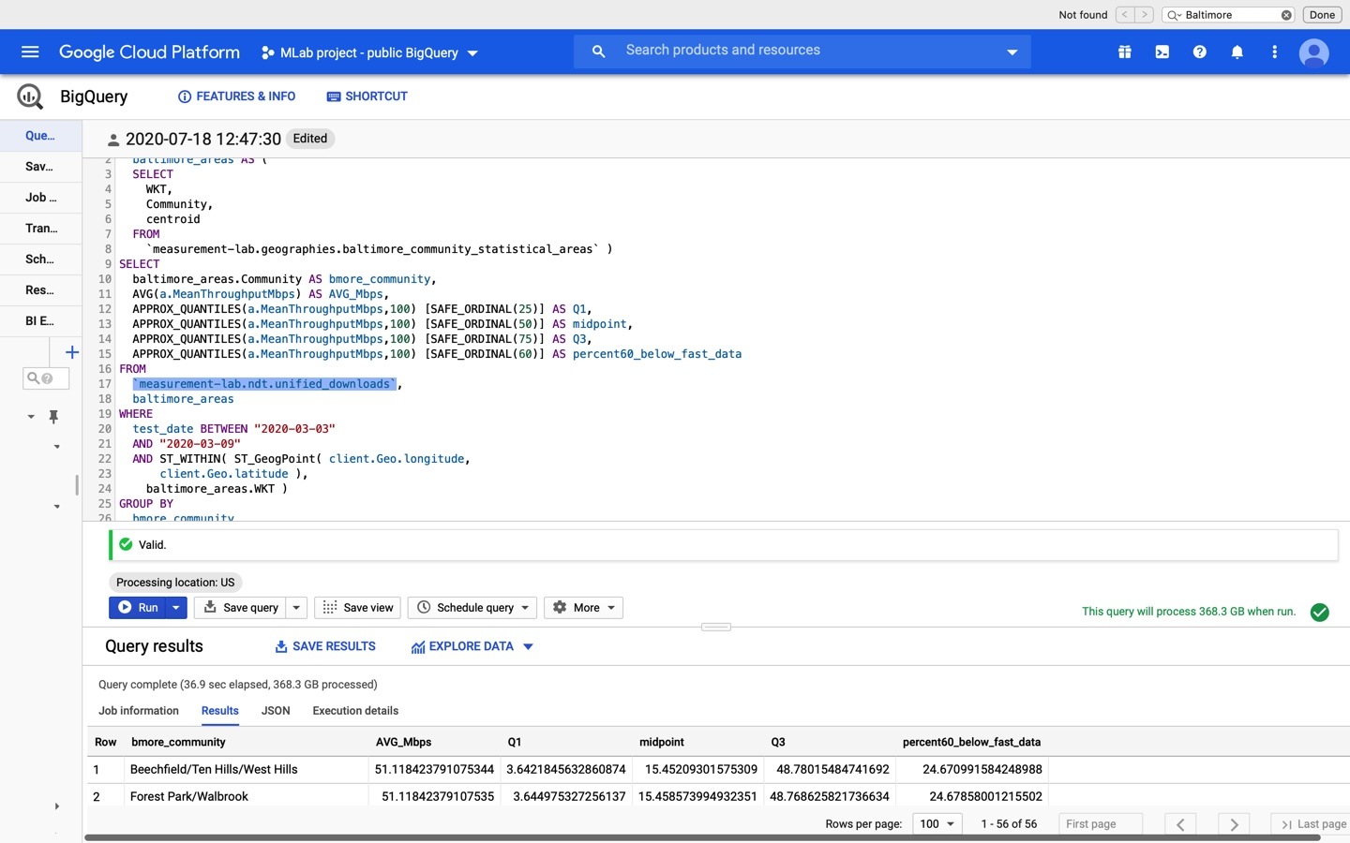
The process

Slide 5
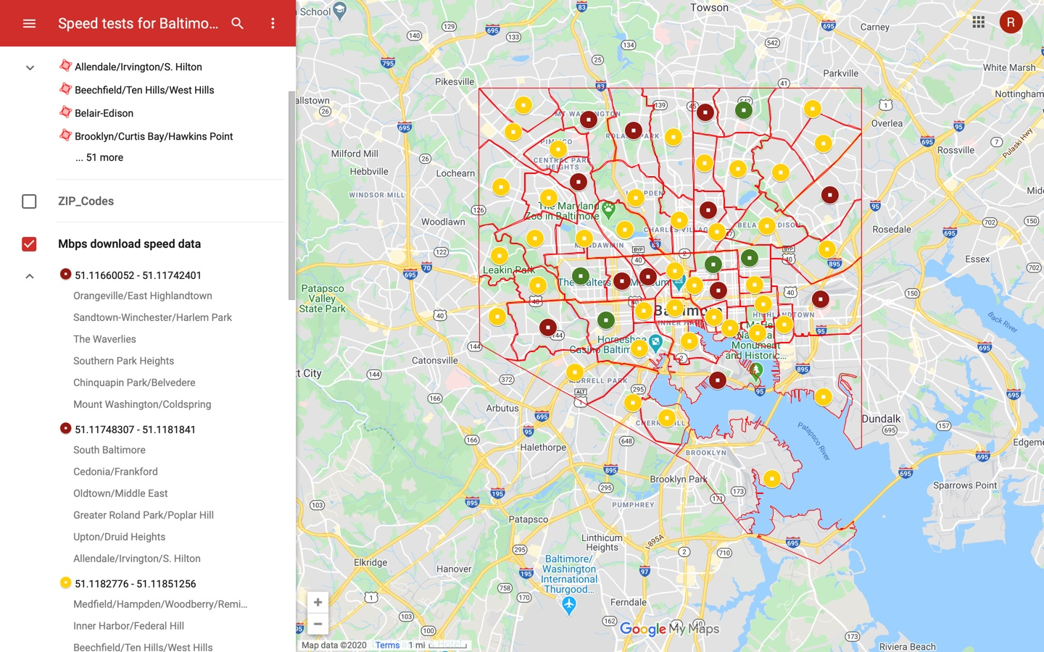
Interactive Map Link: https://www.google.com/maps/d/edit?mid=1OrqUgMEBWA-kswLi-IJ575PHofSpxMzj&usp=sharing

Slide 6
Baltimore Communities with the lowest Average Download Speed
Community | Average Speed(mbps) | Q1 (25%) | Median | Q3 (75%) | Top 95%
Orangeville/East Highlandtown | 51.116600 | 3.6391 | 15.4764 | 48.7871 | 217.3765
Sandtown-Winchester/Harlem Park | 51.116967 | 3.6390 | 15.4556 | 48.7509 | 217.0754
The Waverlies | 51.117055 | 3.6383 | 15.4500 | 48.7074 | 217.3692
Southern Park Heights | 51.117123 | 3.6468 | 15.4649 | 48.8004 | 217.5852
Chinquapin Park/Belvedere | 51.117201 | 3.6451 | 15.4483 | 48.7943 | 217.3948
Mount Washington/Coldspring | 51.117424 | 3.6366 | 15.4483 | 48.7186 | 217.0319
South Baltimore | 51.117483 | 3.6462 | 15.4766 | 48.7464 | 217.1376
Cedonia/Frankford | 51.117553 | 3.6455 | 15.4666 | 48.7686 | 217.0327
Oldtown/Middle East | 51.117584 | 3.6443 | 15.4715 | 48.7404 | 217.4517
Greater Roland Park/Poplar Hill | 51.117696 | 3.6433 | 15.4571 | 48.7598 | 217.0754
Upton/Druid Heights | 51.118042 | 3.6412 | 15.4496 | 48.7374 | 217.2937
Allendale/Irvington/S. Hilton | 51.118184 | 3.6480 | 15.4733 | 48.8057 | 217.3703

Slide 7
Summary
Not exhaustive (voluntary participation, does not account for those without internet)
The data is very uniform across Baltimore City
Baltimore city as a whole: about 61% have speeds at or below 25mbps
Maryland as a whole: about 35% have speeds at or below 25mbps
There is so much more to be explored on this issue

