Slide 1

Data for Youth Opportunities
Presented by Sarah Wallace

Slide 2

What does data mean to youth?
Data is used in statistics
Data is used for computer info
Data is used in regular information

Slide 3

How do people use data?
People use data to become more self aware
People use data to determine how to best help their community
People use data to empower themselves and their organizations

Slide 4




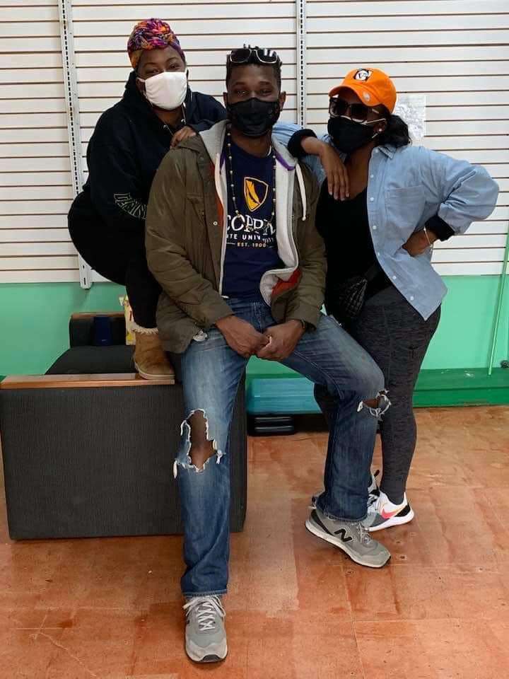





Personal experience in community with Data
Accelerator programs
School systems
Grants
Opportunities & Fun

Slide 5



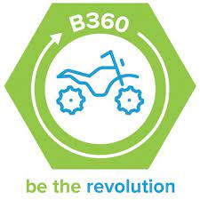
How can youth use data for themselves?
Advocacy
Empowerment
Creation of almost anything
Awareness
Examples:

Slide 6



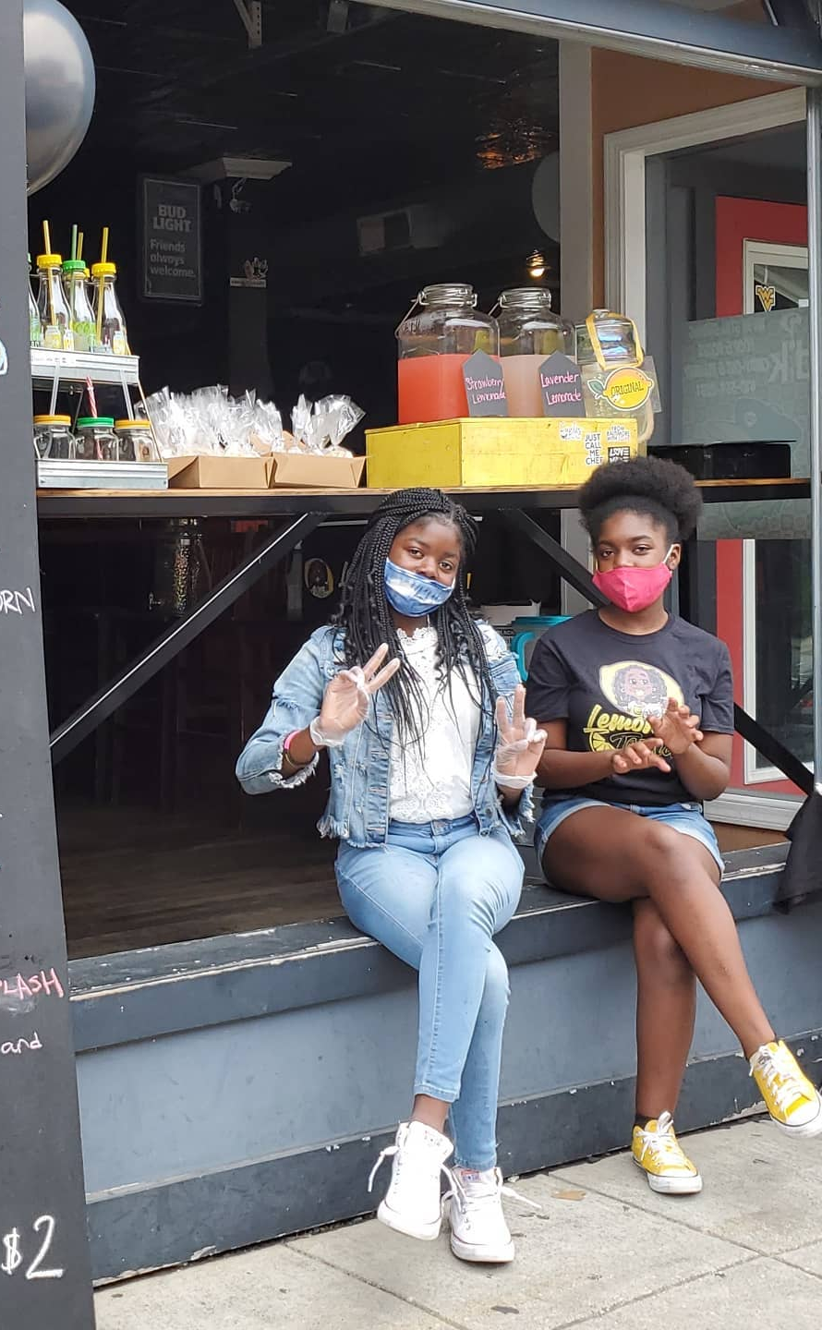
Moving forward in a positive way
Continue to utilize data to move the youth, our communities, and our
city forward in a positive light.

Slide 7


Thank you!!

