Slide 1
MARYLAND HOUSING NEEDS ASSESSMENT

Slide 2
Agenda
Introduction
Overview of Housing Needs Assessment
Tools in the document
Data indices
Online mapping
Q&A

Slide 3
What is the NCSG?
Research center at UMD College Park
Based in the School of Architecture, founded in 2000
Technical assistance to local and state government; grant recipient from NSF, federal government, foundations
5 urban planning faculty
15 staff and student employees
Mission:
The NCSG works to create a more sustainable, vibrant and enhanced quality of life for communities across the globe. While we continue to address smart growth issues around the world, we are also engaged extensively at the local level on issues like housing, transportation, climate, and equity.
We did the “opportunity mapping” about 7 years ago for the sustainable communities initiative – “Opportunity Collaborative.

Slide 4
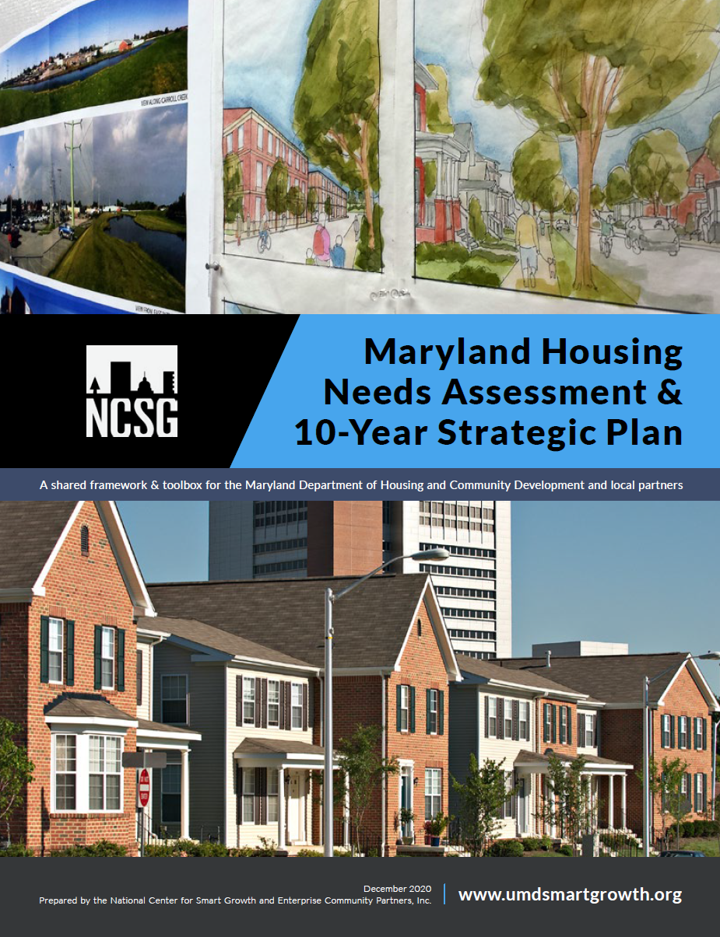
The Maryland Housing Needs Assessment

Slide 5
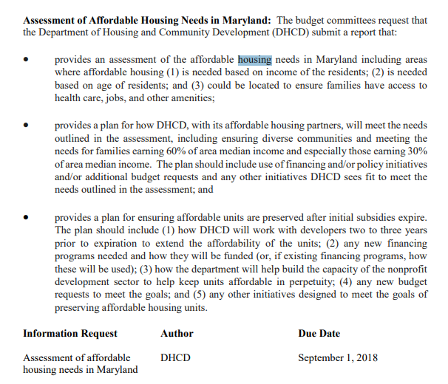
Background on the “HNA”
2018: State legislative mandate to DHCD to conduct the needs assessment
2019: RFP out
NCSG and Enterprise Community Partners apply and are selected, summer 2019
Fall 2019: NCSG and Enterprise begin work
March-Fall 2020 = COVID delays!
December 2020: project wraps up
February 2021: release of final report

Slide 6
PROJECT GOALS MARYLAND HOUSING NEEDS ASSESSMENT
ASSESSMENT OVERVIEW
Provides accurate analysis about housing needs in the State of Maryland between 2020 and 2030.
Proposes a menu of recommendations, including new tools at the state and local levels to better align with current and future housing needs.
Focuses on ways to meet the needs for all income groups, including those affecting families earning 30% and 60% of area median income.

Slide 7
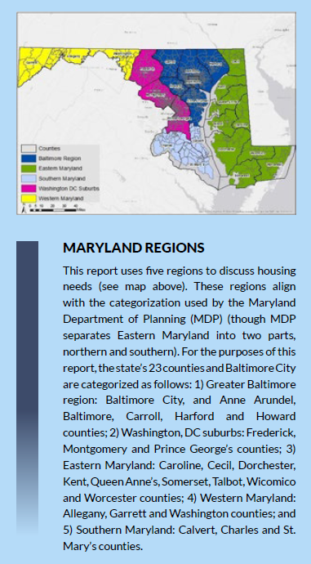
What’s in this report? It’s 300 pages!
Proposed statewide priorities
What are the biggest issues?
Assessment of current and future conditions
Supply, demand, projected demographic and economic situation
Identification of needs by region
How do needs in the housing market differ across the state?
Policy toolbox
A “menu of actions” not a prescriptive policy roadmap
Appendices
State and local policy review
Engagement summary
Technical documentation
Supplementary data

Slide 8
THREE SUPPORTIVE TOOLS MARYLAND HOUSING NEEDS ASSESSMENT
ASSESSMENT OVERVIEW
Homeowner Stability Index
Renter Stability Index
Maryland’s Housing Toolbox
Full Housing Needs Assessment | Renter & Homeownership Stability Indices | Maryland Housing Toolbox

Slide 9
TOOLS PROVIDED IN THE HOUSING NEEDS ASSESSMENT: INDICES

Slide 10
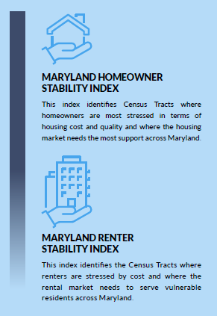
Needs by geography/Indices
Two numeric indices
Every census tract in the state
Ranked within each of the 5 regions
Comparable scores across the state
Organizes tracts from lowest to moderate to highest need
Data is shared with the public (housing needs assessment tables folder on DHCD website)
Online mapping

Slide 11
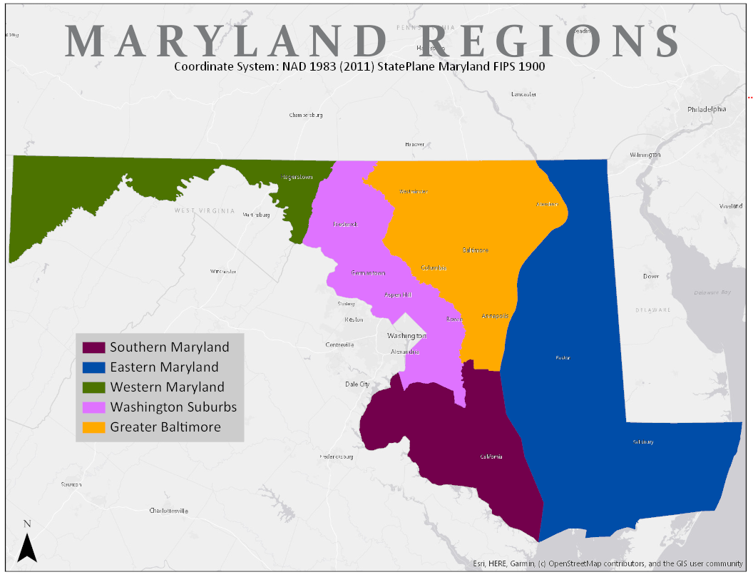
APPROACH TO IDENTIFY PRIORITY NEEDS
PRIORITY NEEDS BY GEOGRAPHY: BACKGROUND
DEFINING REGIONS
We used the five regions identified for this project (see map):
Washington suburbs
Greater Baltimore
Southern Maryland
Western Maryland
Eastern Maryland
COMPARING RESULTS
The index values are comparable statewide, but tracts are ranked by quintile uniquely in each region.
This allows comparison of differences in a region.
Notes:
*If tracts were ranked statewide, needs would be 'washed out' of certain areas

Slide 12
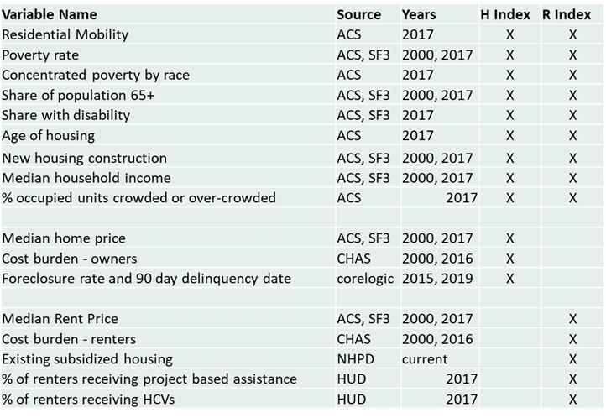
APPROACH TO IDENTIFY PRIORITY NEEDS
PRIORITY NEEDS BY GEOGRAPHY: BACKGROUND
Data
2013- 2017 ACS
2000 SF3 Census
Corelogic
HUD
NHPD
1394 census tracts in Maryland
Z-scores computed relative to state average
Capped at –3.5/+3.5
Tracts separated into regions, split into equal quintiles (lowest need to highest need) in each region
More on methods: appendix F

Slide 13
PRIORITY NEEDS BY GEOGRAPHY HOMEOWNER INDEX METHODS
PRIORITY NEEDS BY GEOGRAPHY: BACKGROUND
GOAL
VARIABLES
RESULTS
Create an index that shows where homeowners are most stressed and the housing market needs the most support.
Age of housing
Turnover/mobility
Home prices
Share of population 65+
Foreclosures and delinquency
Housing construction trends
Cost burdens among owners
Poverty rate
Median income
HIGHEST NEED MEANS…
Tracts with high poverty rates, older housing, high cost burdens, high rates of crowding, low home prices, and high shares of delinquent or foreclosed loans,
LEAST IN NEED MEANS…
Tracts with high incomes, newer housing, lower cost burdens,high home prices, and few foreclosures or delinquencies.
Notes:
,

Slide 14
RENTER NEEDS BY GEOGRAPHY INDEX METHODS
RENTER STABILITY: A COMMON WAY TO LOOK AT NEED
GOAL
VARIABLES
RESULTS
Identifies areas where
renters are stressed by cost and the rental market needs to serve vulnerable residents across Maryland.
Age of housing
Turnover/mobility
Rents
Poverty rate
Concentrated poverty by race
Share of population 65+
Share of population w. a disability
Housing construction trends
Cost burdens among renters
Existing subsidized housing
HIGHEST NEED MEANS… Tracts with high poverty rates, older housing, high rents, high cost burdens, high rates of crowding, and large shares of residents receiving assistance. LEAST IN NEED MEANS…
Tracts with high incomes, newer housing, lower cost burdens, and lower shares of renters receiving assistance.
Notes:
,

Slide 15
Needs by geography web links
Links to the renter and homeowner stability index maps are here
available on page 32 of report, please see Appendix F of the report for technical documentation and a brief user's guide
Statewide
Western MD
Washington DC Suburbs
Greater Baltimore
Eastern MD
Southern MD

Slide 16
THE BALTIMORE REGION A closer look

Slide 17
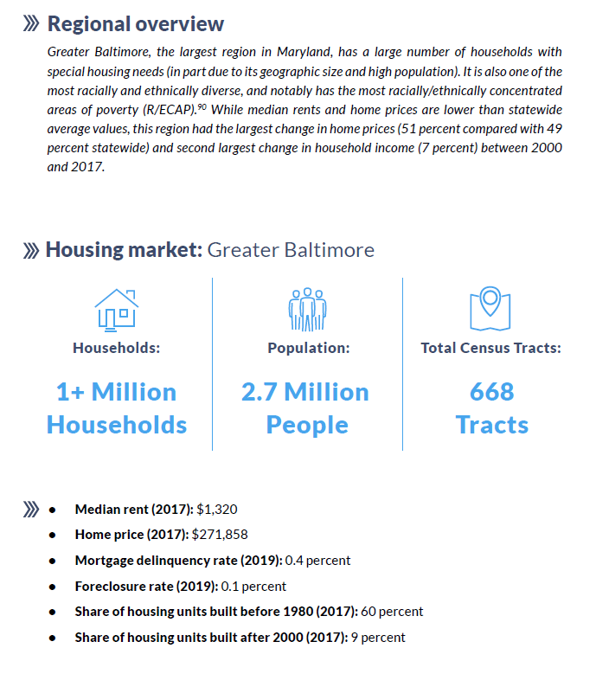
Summary findings
Baltimore Region
Largest region – nearly half the state – lots of differences within and between counties and the CIty
In most ways, the area is “average” because it has so much of the housing stock, but rents and home prices are a bit lower than the state average overall
Biggest concerns: older housing stock, high cost burdens, high poverty and low incomes,

Slide 18
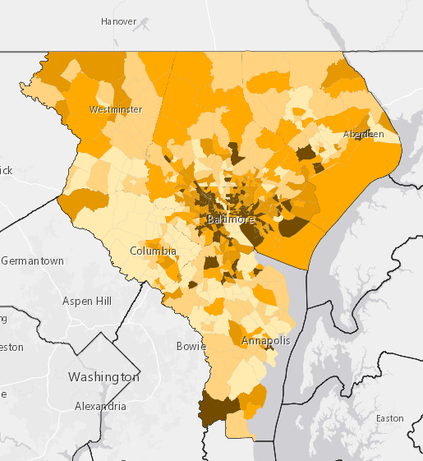
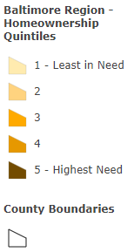
GREATER BALTIMORE OWNER PRIORITY NEEDS
PRIORITY NEEDS BY GEOGRAPHY: OWNER STABILITY
Largest increase in home prices since 2000 (+51%)
Lower-than-average home prices in 2017 ($271,858)
Low delinquency rate (0.4%) & foreclosure rate (0.1%)
Older housing stock (only 9% of units built since 2000)*
*Housing need is not tenure-specific.
Notes:
Not exactly a housing need, but potentially relevant context from the demographic overview for Baltimore: this region is where most of the R/ECAPs in the state are (22 out of 23)

Slide 19
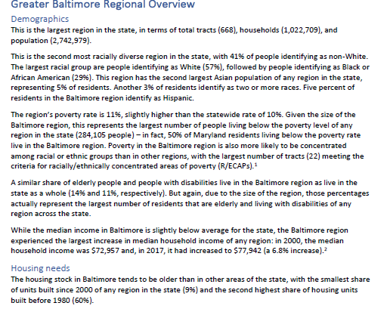
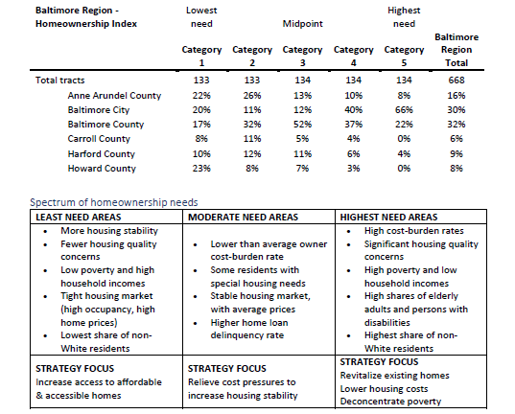
Homeownership Index – for more, see appendix G
Baltimore Region
Detailed breakdown of the statistics and comparison to state levels
Analysis of each of the 5 categories of need – for example, for homeowner index:

Slide 20
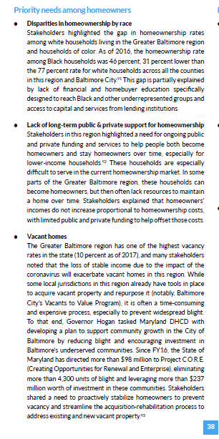
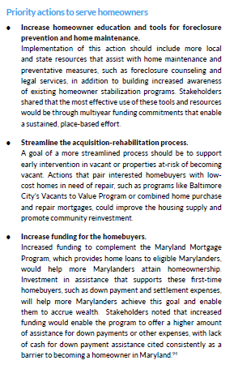
Homeownership needs and actions
Baltimore Region

Slide 21
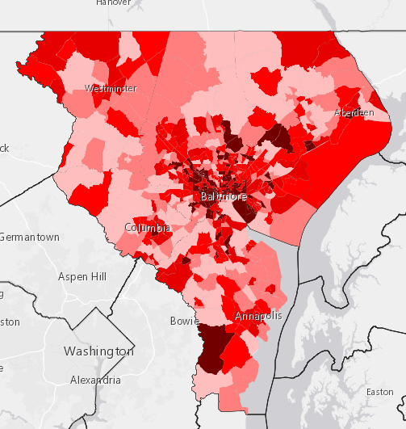
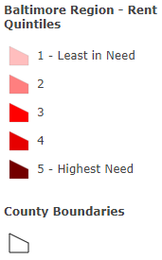
GREATER BALTIMORE RENTER PRIORITY NEEDS
PRIORITY NEEDS BY GEOGRAPHY: RENTER STABILITY
High share of renters (34%)
High rental assistance utilization (across assisted units, vouchers, and other rental assistance)
Moderate renter cost-burden rate (45%)
Lower-than-average median rent ($1,424)
Older housing stock (only 9% of units built since 2000)*
*Housing need is not tenure-specific.

Slide 22
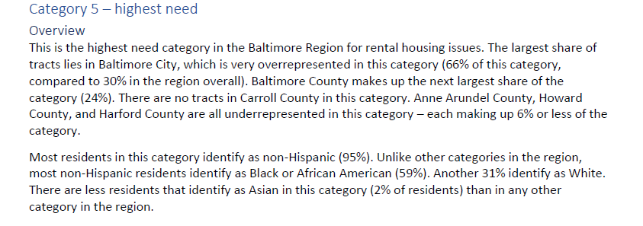
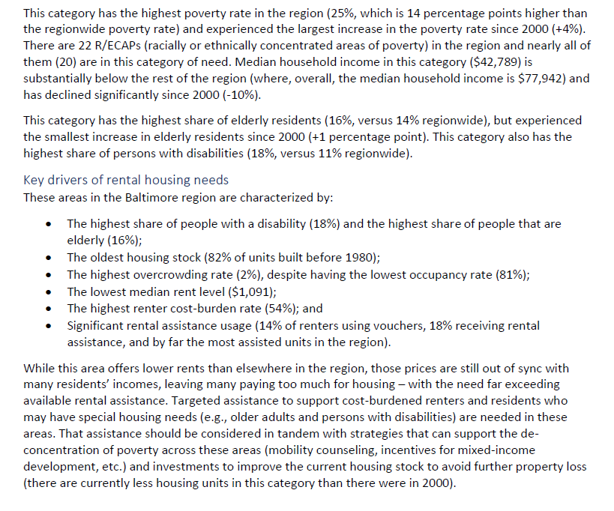
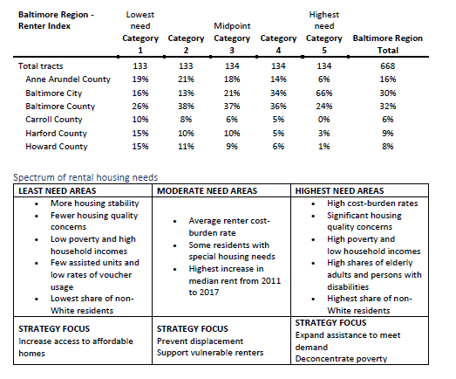
Rental Index – for more, see appendix G
Baltimore Region
Detailed breakdown of the statistics and comparison to state levels
Analysis of each of the 5 categories of need – for example, for rental index:

Slide 23
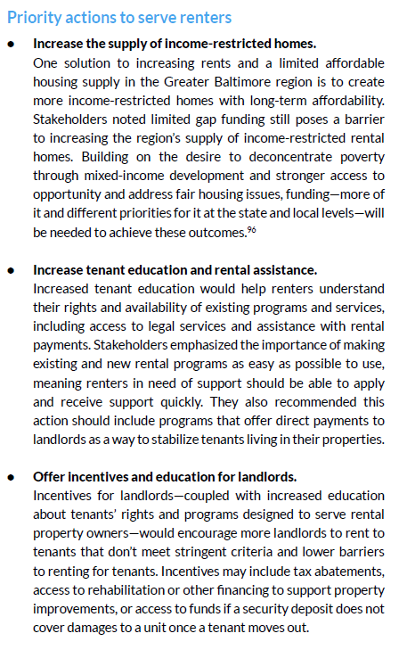
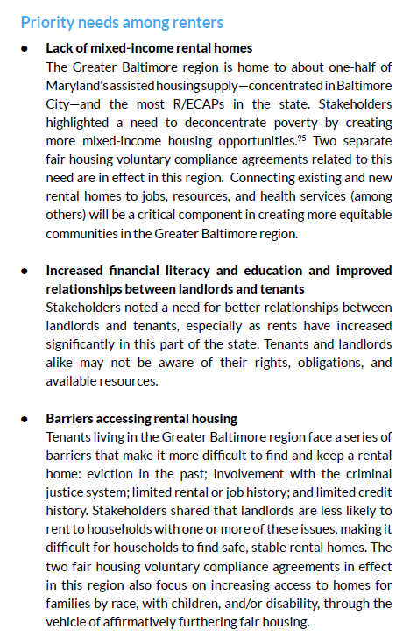
Rental market needs and actions
Baltimore Region

Slide 24
Needs by geography web links
Links to the renter and homeowner stability index maps are here
available on page 32 of report, please see Appendix F of the report for technical documentation and a brief user's guide
Statewide
Western MD
Washington DC Suburbs
Greater Baltimore
Eastern MD
Southern MD

Slide 25
COMMENTS OR QUESTIONS

Slide 26
THANK YOU
PHOTO CREDITS: ODI via Flickr | Maryland Govpics | Jay Baker via Flickr | Joseph A via Flick | Doug Kerr via Flickr

