Slide 1
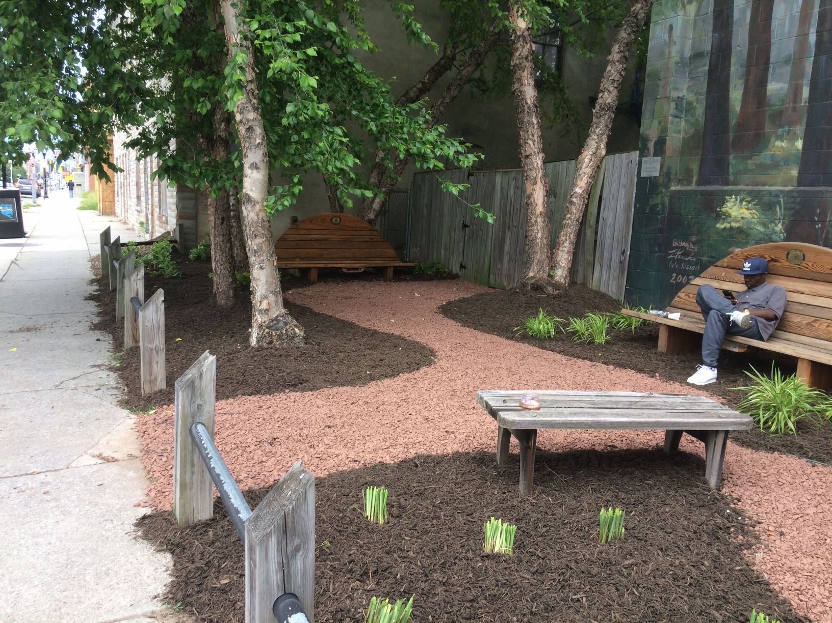
Can restoring vacant lots improve adolescent health disparities?
Kristin Mmari, Dr.PH, MA

Slide 2
Background
People living near vacant lots and abandoned buildings exhibit poor health…But, growing evidence suggests that when vacant lots are greened and restored, the health of nearby residents improves.
While most research to date has focused on adult residents, far less is known about the impact that vacant lot restoration has on the health of adolescents.
Even though adolescents spend more time in the areas surrounding their homes than adults, AND
Neighborhood research shows that adolescents have much different experiences and perceptions of neighborhood compared to adults

Slide 3
Situation in Baltimore
Baltimore City has over 18,000 vacant lots and additional 17,000 abandoned buildings (Baltimore Green Network)
Approximately 900 vacant lots have been greened to date; but restoration is variable
Mowing and trash pick up
Community gardens
Raised flowerbeds and tree planting
Art murals
The City and many other NGOs have a plan to ‘clean and green’ every vacant lot… and this provides us with a great opportunity to examine the impact of various restoration activities on the health of adolescent residents

Slide 4
SCIBAR Award (Support for Creative Integrated Basic and Applied Research)
Overall study goal: To determine whether vacant lot restoration strategies reduce health disparities among young people, including what types of restoration works best, for whom, and why.
Short-term objectives:
Build a sharable database containing key characteristics of restored and unrestored vacant lots;
Conduct a mixed-methods longitudinal study on changes in adolescent health associated with exposure to vacant lot restoration
Embed a cost-effectiveness study to determine the impact of different restoration programs on youth crime and violence; mental health; and food insecurity; and
Develop and disseminate a blueprint for reducing adolescent health disparities through lot restoration strategies that can be adapted for different U.S. municipalities.

Slide 5
Our Team
A multi-sectoral collaboration of individuals and organizations including:
Researchers across four different departments in JHSPH, University of Maryland, Baltimore Neighborhood Indicator Alliance at University of Baltimore, as well as the U.S.D.A Forest Service
State and local agencies, including the Baltimore Office of Sustainability and the Maryland Department of Housing and Community Development, and
Community-based organizations, including Baltimore Green Space, Parks and People Foundation, and National Recreation and Parks Association,
And more are joining ☺

Slide 6
Our focus for today: building a sharable database
Database development is coordinated and housed by BNIA
Biggest need: ensuring we have greening data!!!
Database will characterize all lot restoration programs by:
Location of greening activities
Organizations involved
Type of greening
Level of maintenance (among others)

Slide 7
Conducting mixed-methods longitudinal study
Three primary health outcomes will be examined among young people:
Exposure to crime and violence
Mental health (depression, anxiety, trauma symptoms, and some positive mental health outcomes (hope and happiness)
Food insecurity
Adolescent survey: Data will be collected among approximately 750 adolescents aged 14-19 years, who will be surveyed 3x over the course of a 10-week growing season: before, during, and after
Recruitment will be spatially confined to areas with sufficient lot density and high adolescent populations (at least 25% of households)
Observations of Neighborhood and Lot environments: Youth researchers (including graduate and young people from community) will be trained to conduct lot assessments to measure quality
In-depth interviews: Approximately 21-24 adolescents aged 14-19 years who live next to restored vacant lots (with varying levels of quality) will be interviewed to gather perceptions of impact of restored vacant lots

Slide 9
Projected impact of study
With increased urbanization, there will be mounting pressure to limit the availability of greenspace within an urban area… our findings will show the importance of greenspace for health and health equity;
The development of a GIS-ready comprehensive database can serve as a resource for decision-making for future greenspace development and future grants and data monitoring systems
Study also incorporates the voices of young people, which have not been centered in vacant lot restoration research or programs thus far

Slide 10
THANK YOU!!

